Slide 1
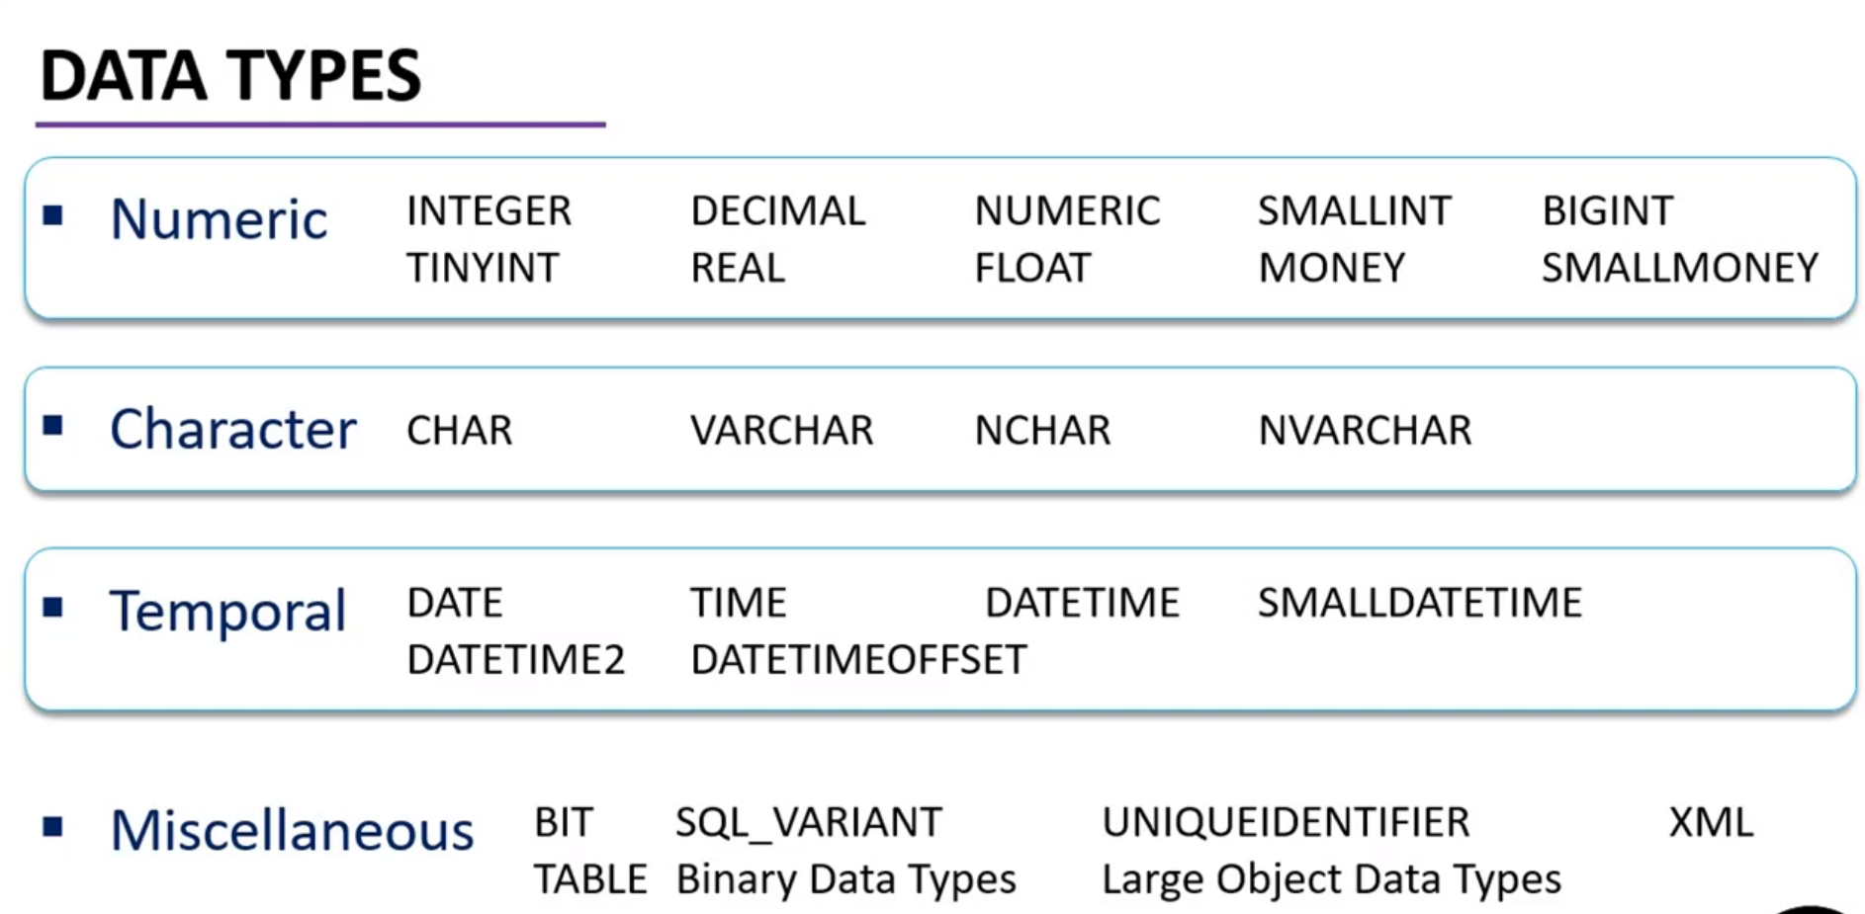

Slide 2
Certainly! Here's a table with common data types in Microsoft SQL Server:
| Data Type | Description |
|-------------------|----------------------------------------------------------|
| INT | Integer |
| VARCHAR(n) | Variable-length character string (up to n characters) |
| DECIMAL(p, s) | Decimal numbers with p total digits and s decimal places |
| FLOAT(n) | Floating-point number with n bits of precision |
| DATETIME | Date and time |
| VARCHAR(MAX) | Variable-length character string with maximum length |
| DECIMAL(MAX) | Decimal numbers with maximum precision |
| NVARCHAR(MAX) | Variable-length Unicode character string with max length |
| BIT | Boolean (0 or 1) |
This table includes some common data types in SQL Server. The `(n)`, `(p, s)`, and `(MAX)` are placeholders for specifying lengths or precision, and you would replace them with actual values when defining columns in a table.
If you have specific data types or scenarios in mind, or if you'd like more details on a particular data type, feel free to let me know!

Slide 3
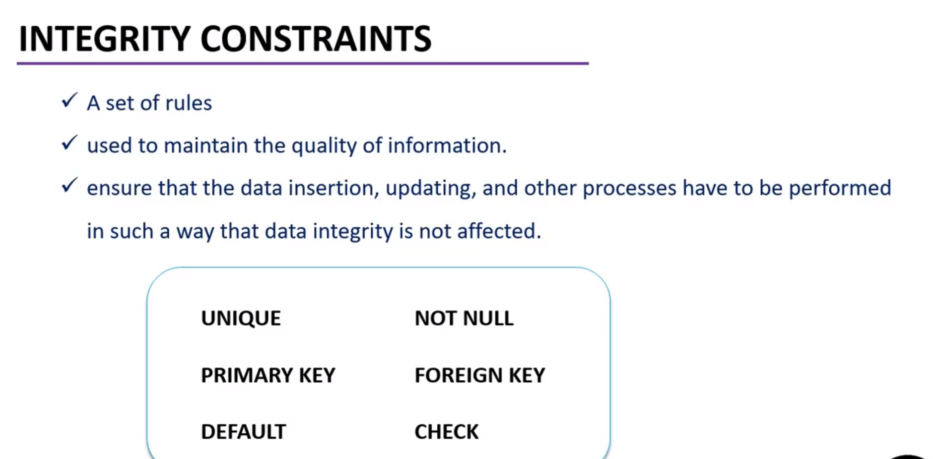

Slide 4
Certainly! Here's a table with common types of constraints in Microsoft SQL Server and their purposes:
| Constraint Type | Description |
|-----------------|--------------------------------------------------------------|
| PRIMARY KEY | Uniquely identifies each record in the table. |
| FOREIGN KEY | Ensures referential integrity between tables. |
| UNIQUE | Ensures that all values in a column are unique. |
| CHECK | Verifies that all values in a column satisfy a condition. |
| DEFAULT | Provides a default value for a column when not specified. |
| NOT NULL | Ensures that a column cannot have a NULL value. |
Please note that this table includes some common constraint types, and there might be others depending on your specific database design. If you have any specific constraints in mind or if you have a particular scenario you'd like assistance with, feel free to provide more details!
CREATE TABLE ExampleTable (
ID INT IDENTITY(1,1) PRIMARY KEY,
Name VARCHAR(50),
-- Other columns...
);
INSERT INTO ExampleTable (Name) VALUES ('John');
INSERT INTO ExampleTable (Name) VALUES ('Jane');
-- The ID column will be automatically generated.

Slide 5
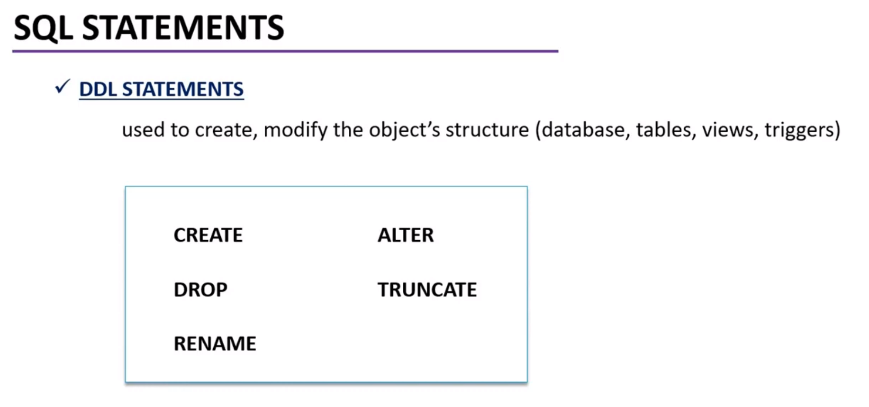

Slide 6
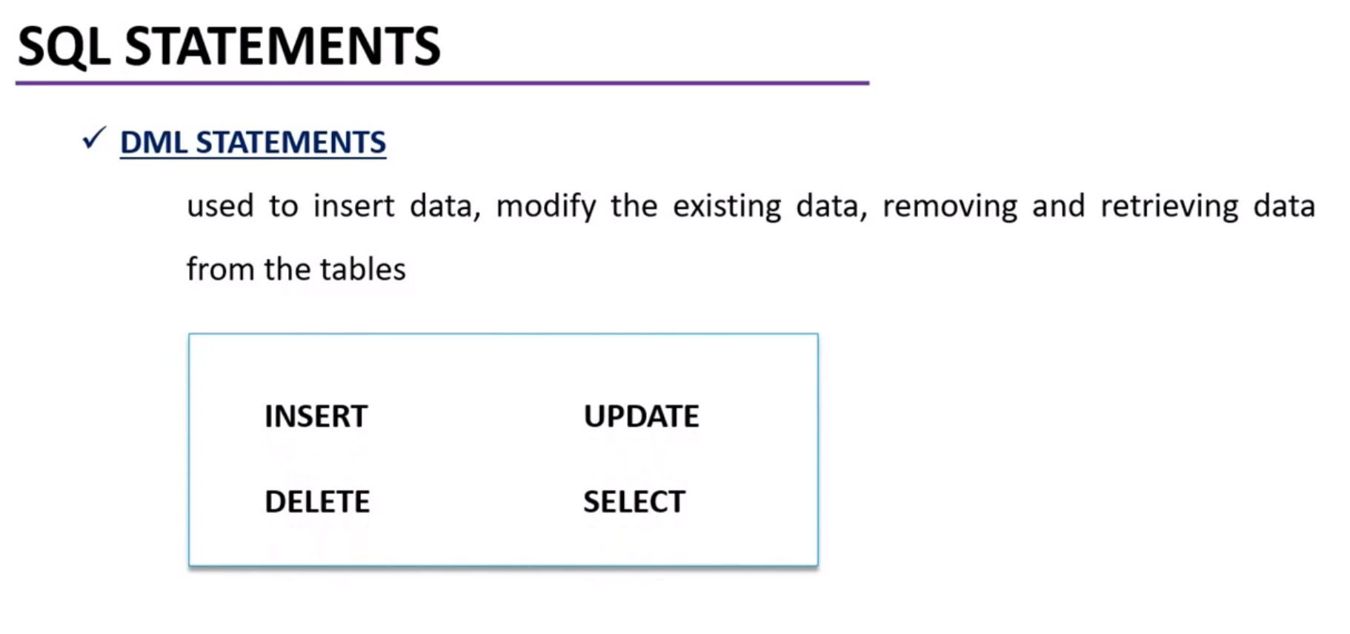

Slide 7
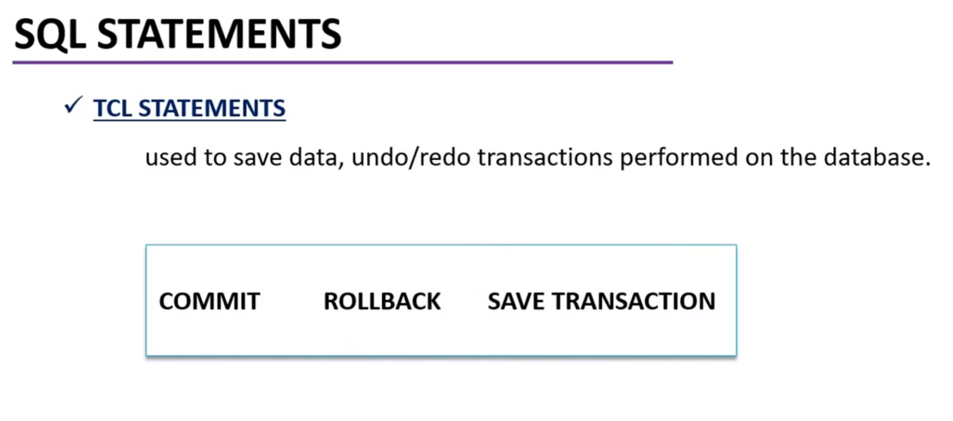

Slide 8
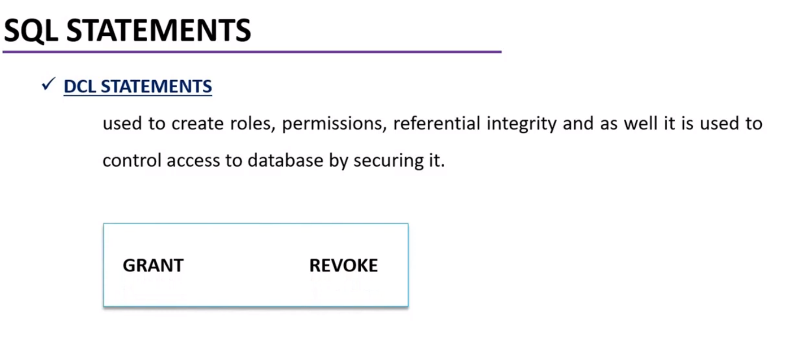

Slide 9
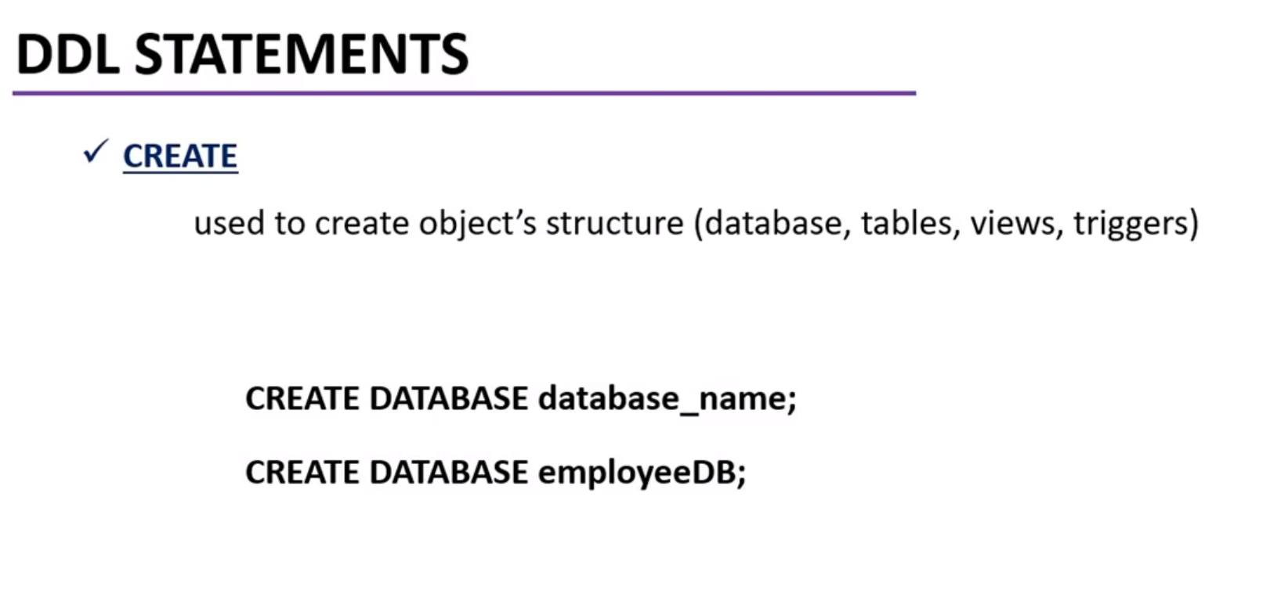

Slide 10
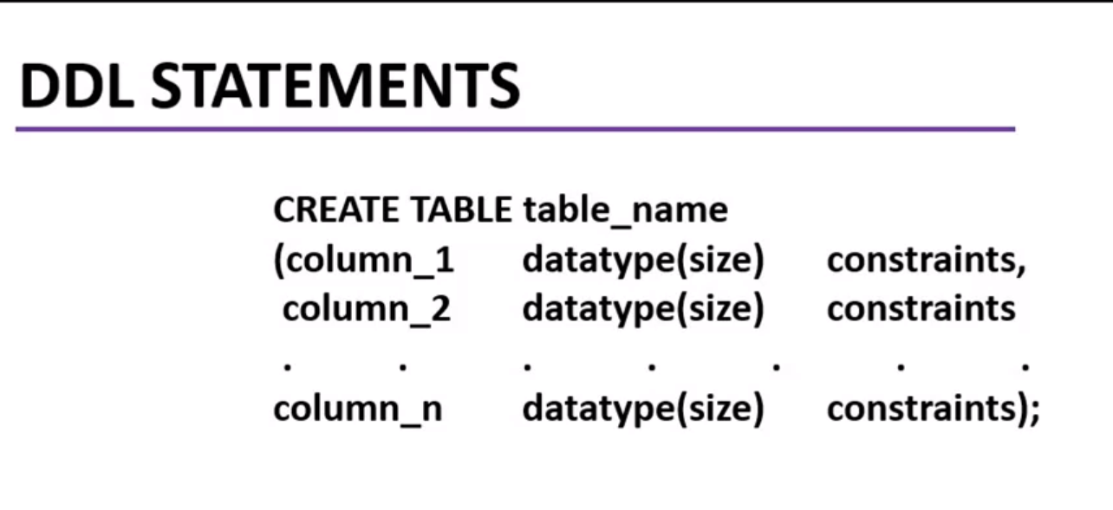

Slide 11
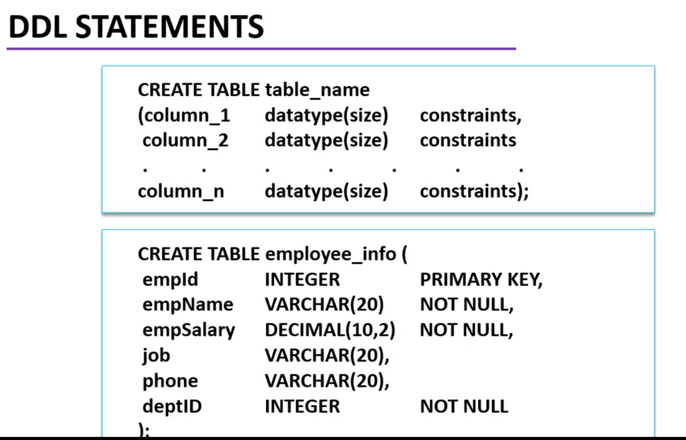

Slide 12
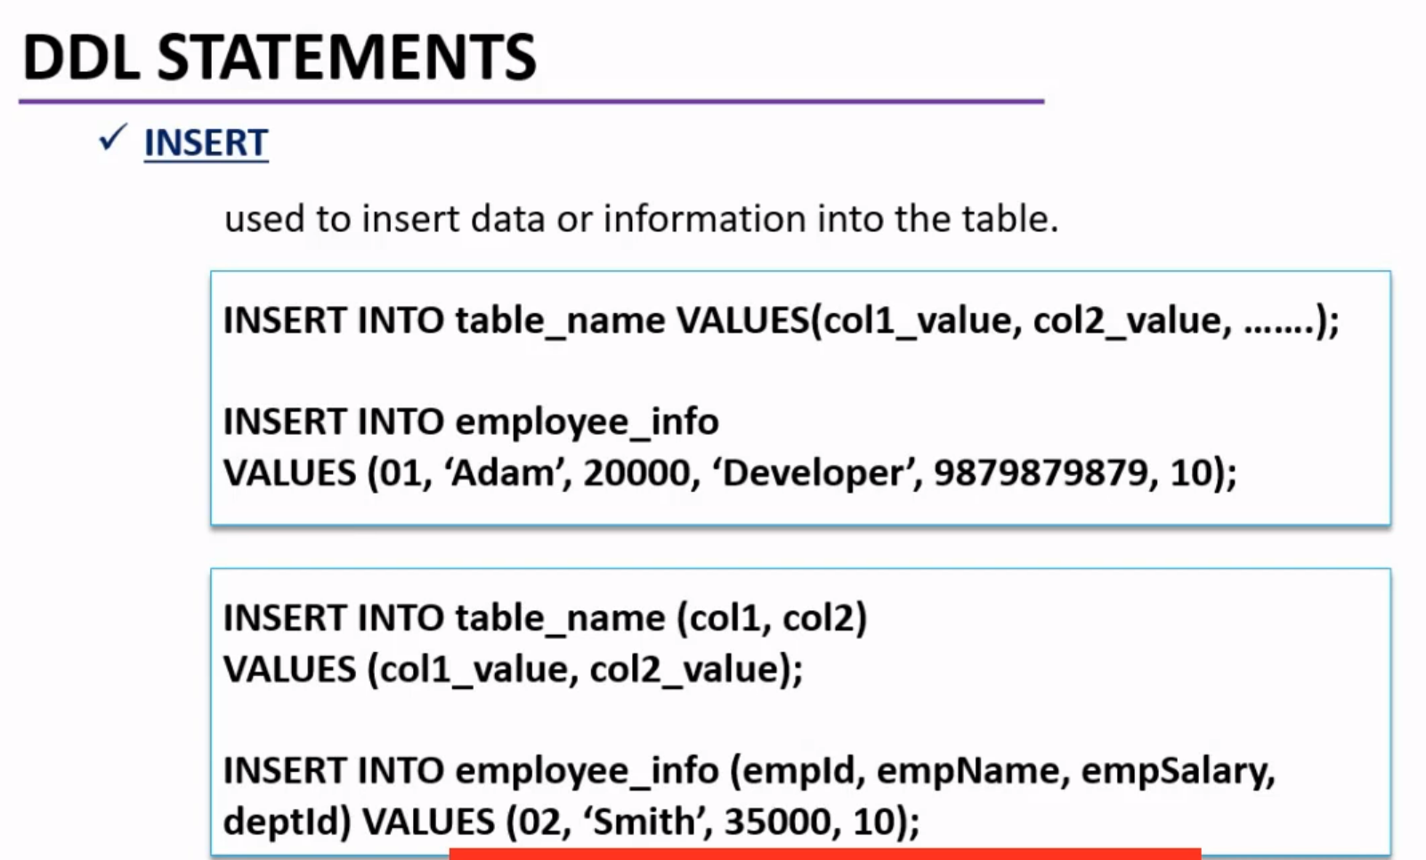

Slide 13
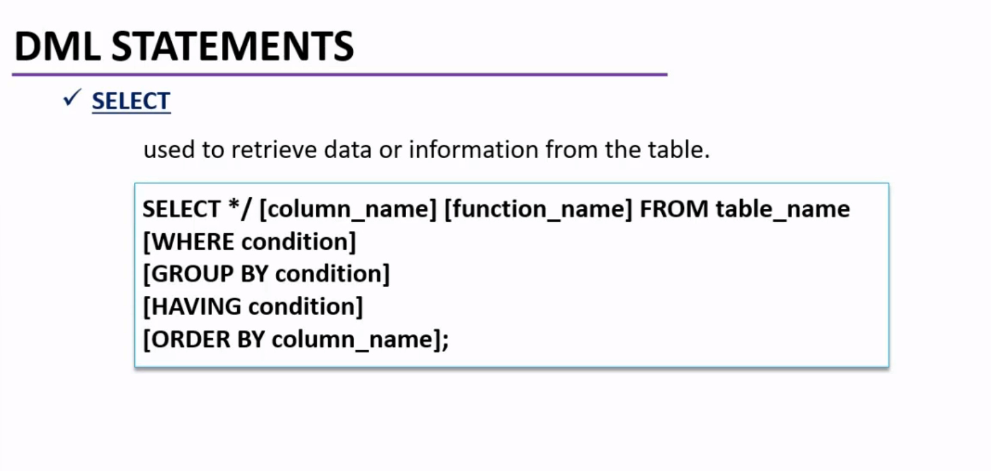

Slide 14
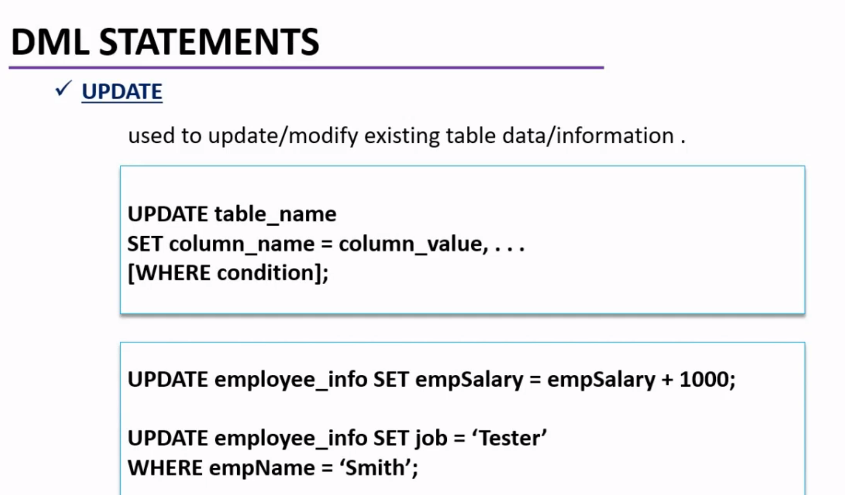

Slide 15
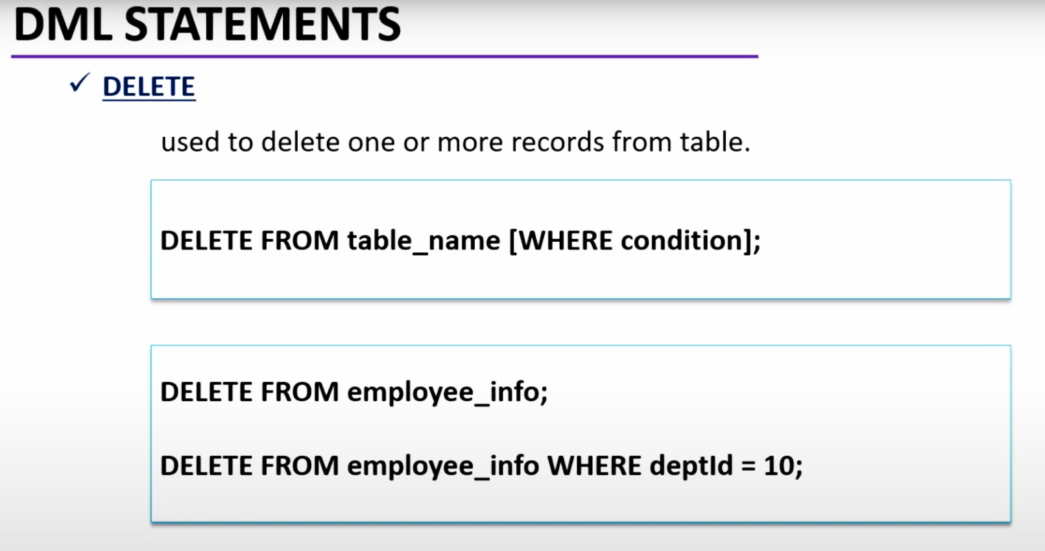

Slide 16
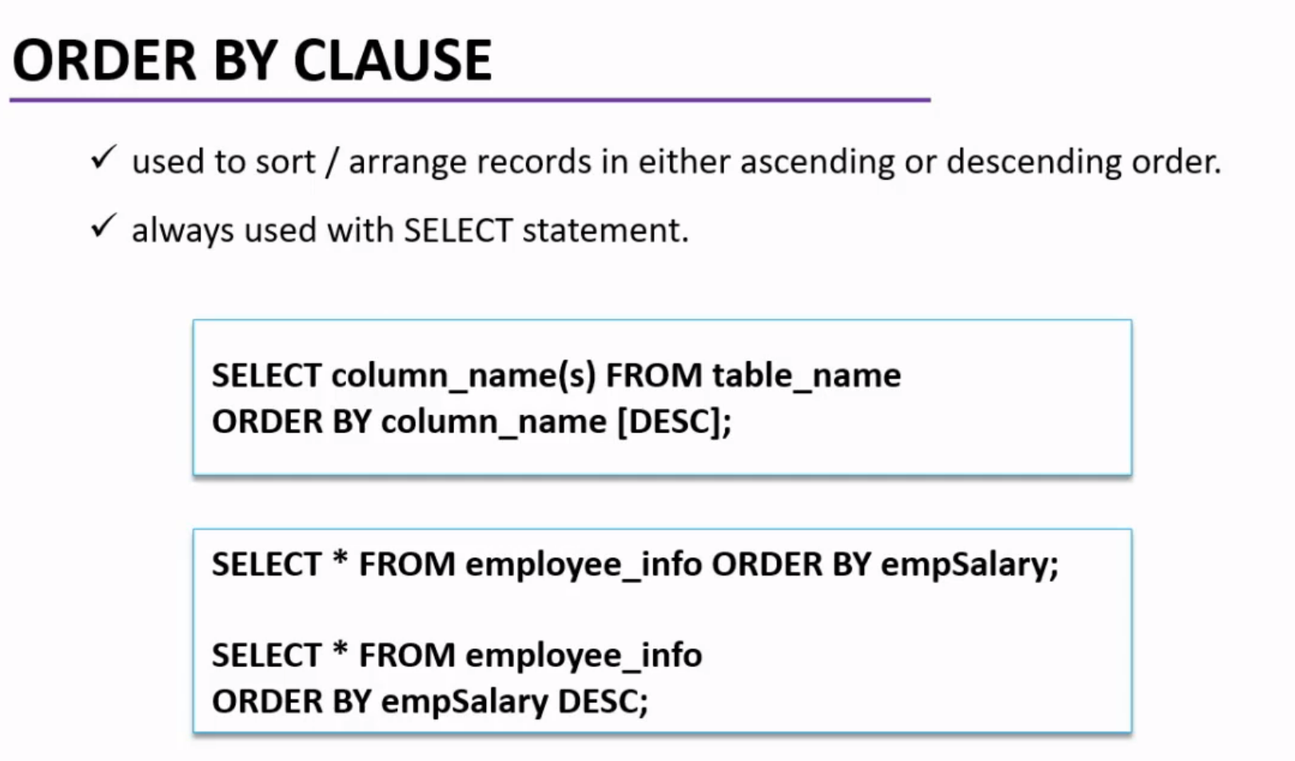

Slide 17
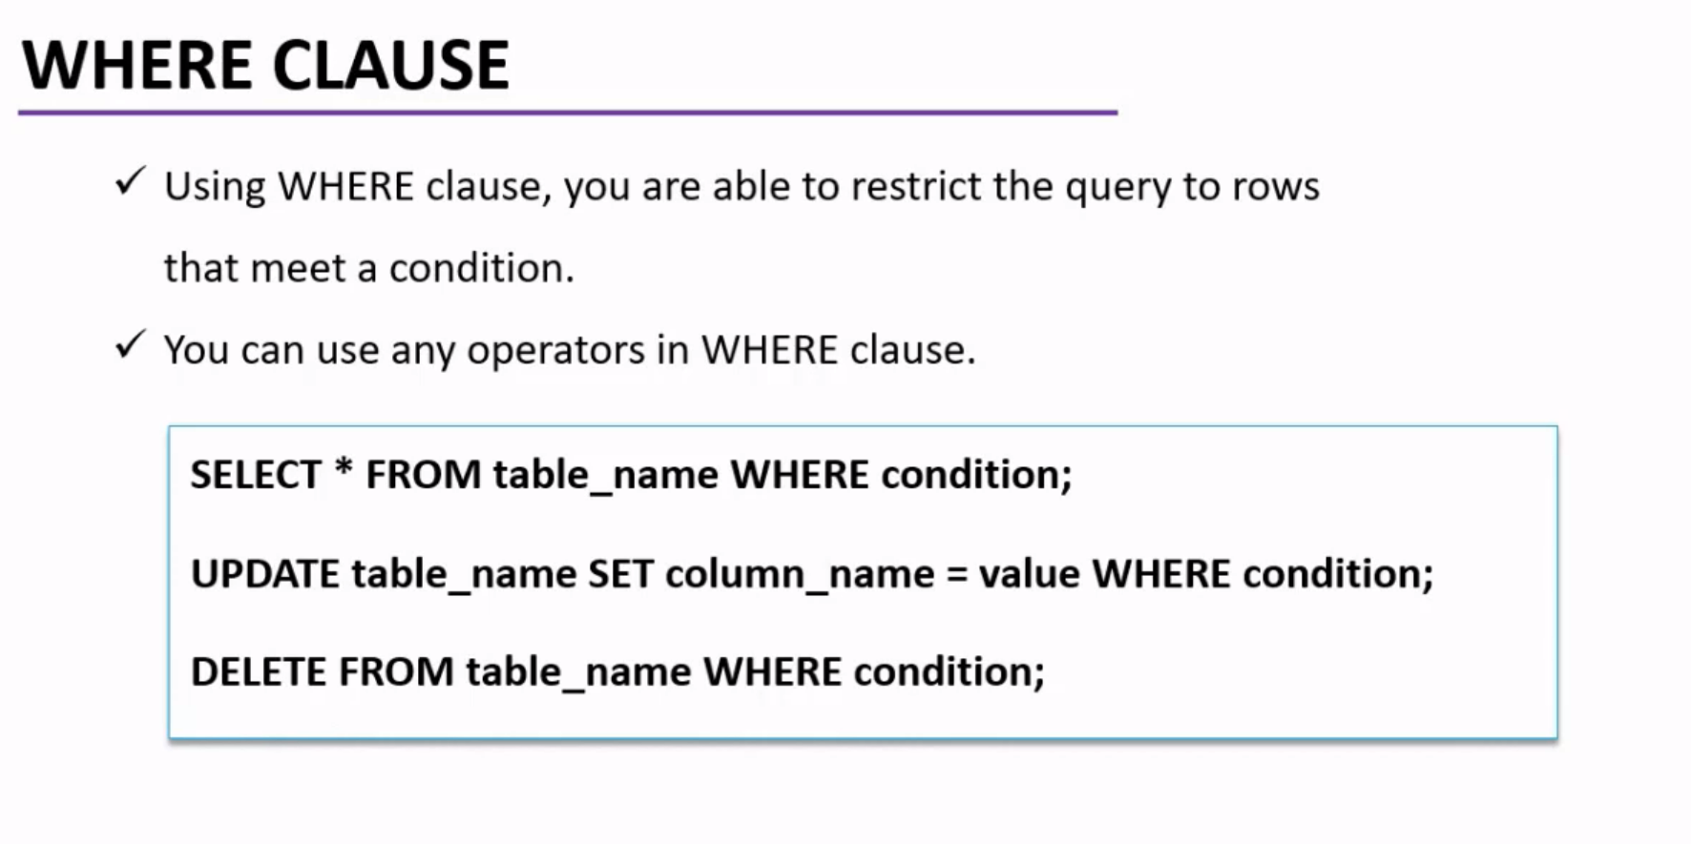

Slide 18
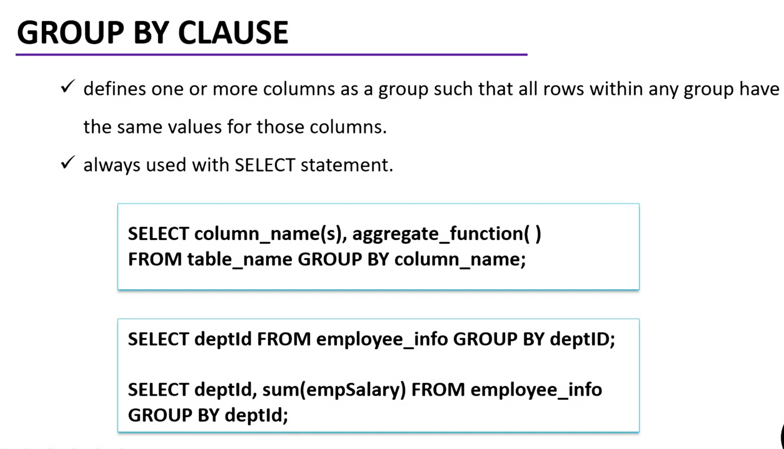

Slide 19
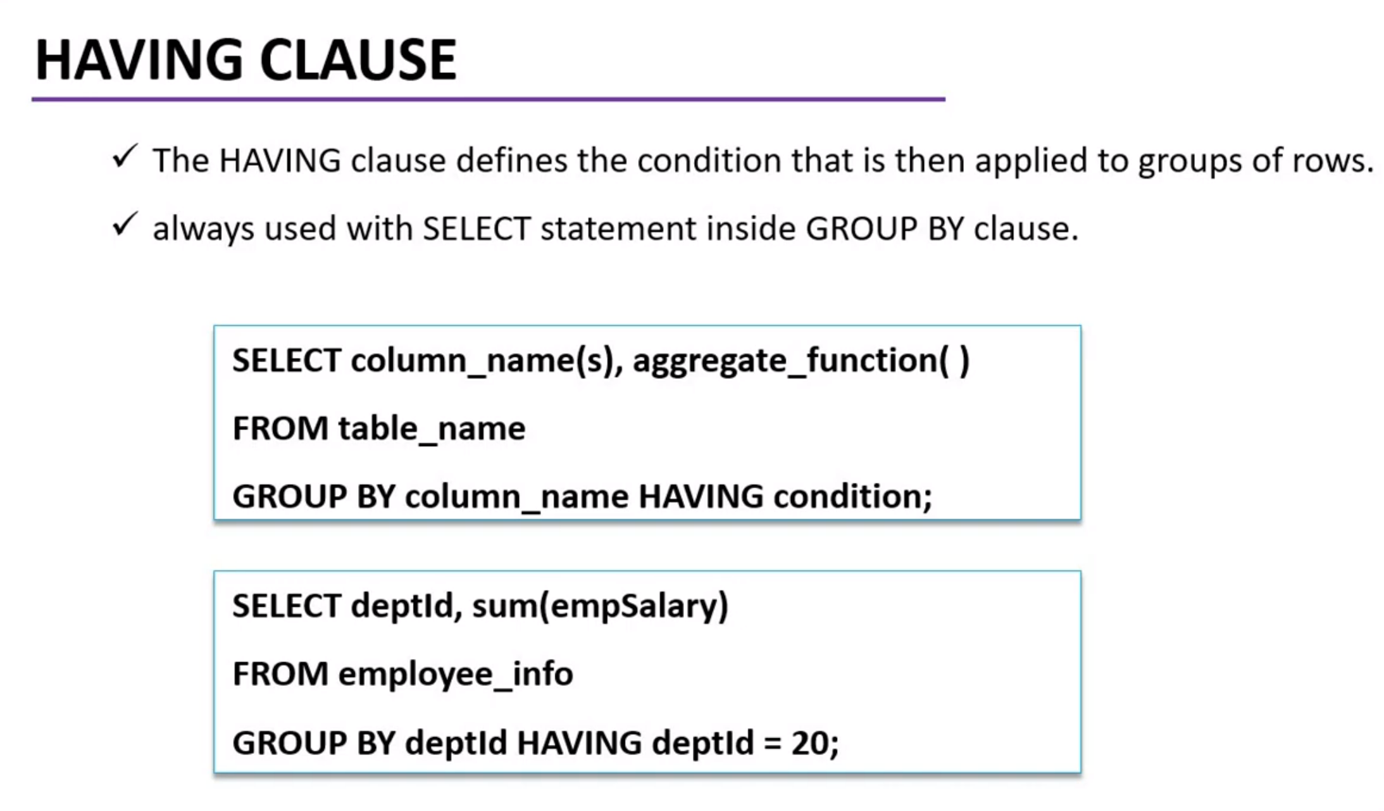

Slide 20
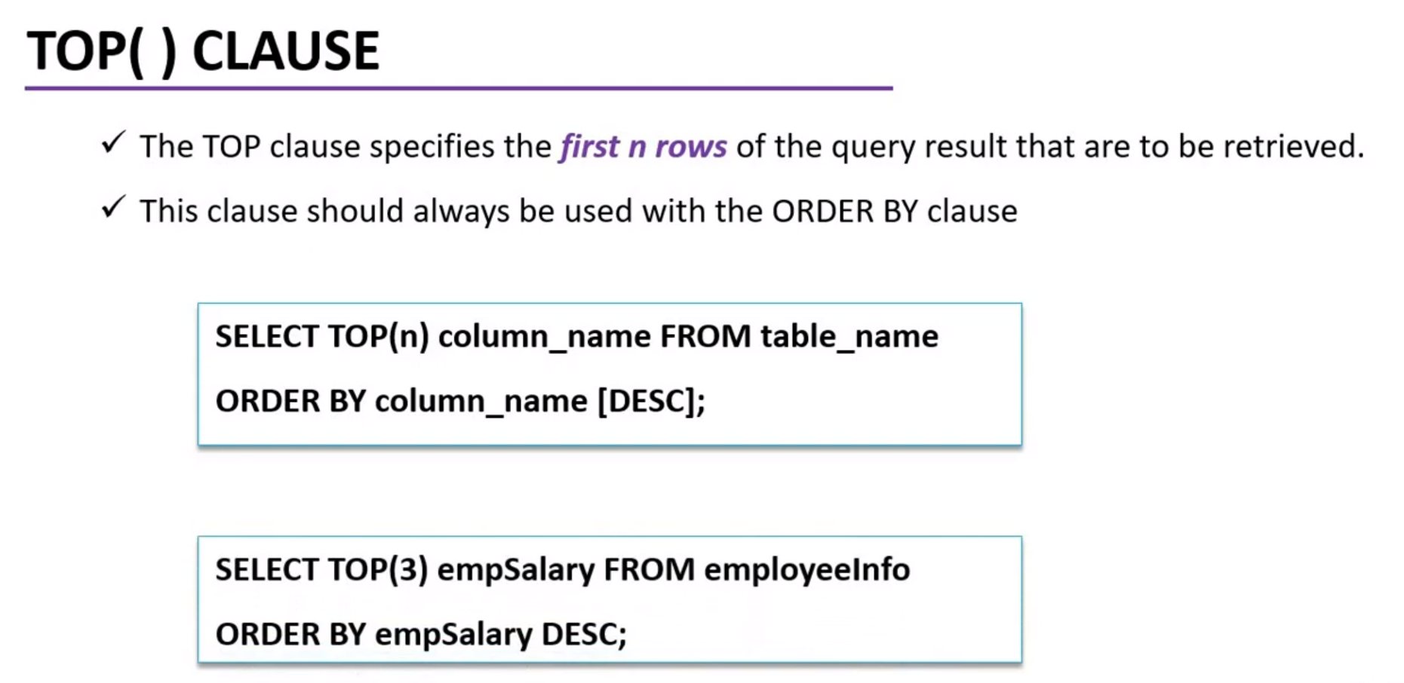

Slide 21
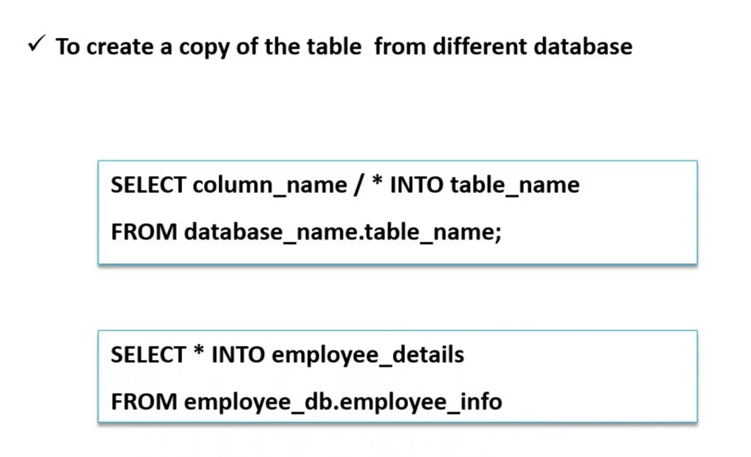

Slide 22
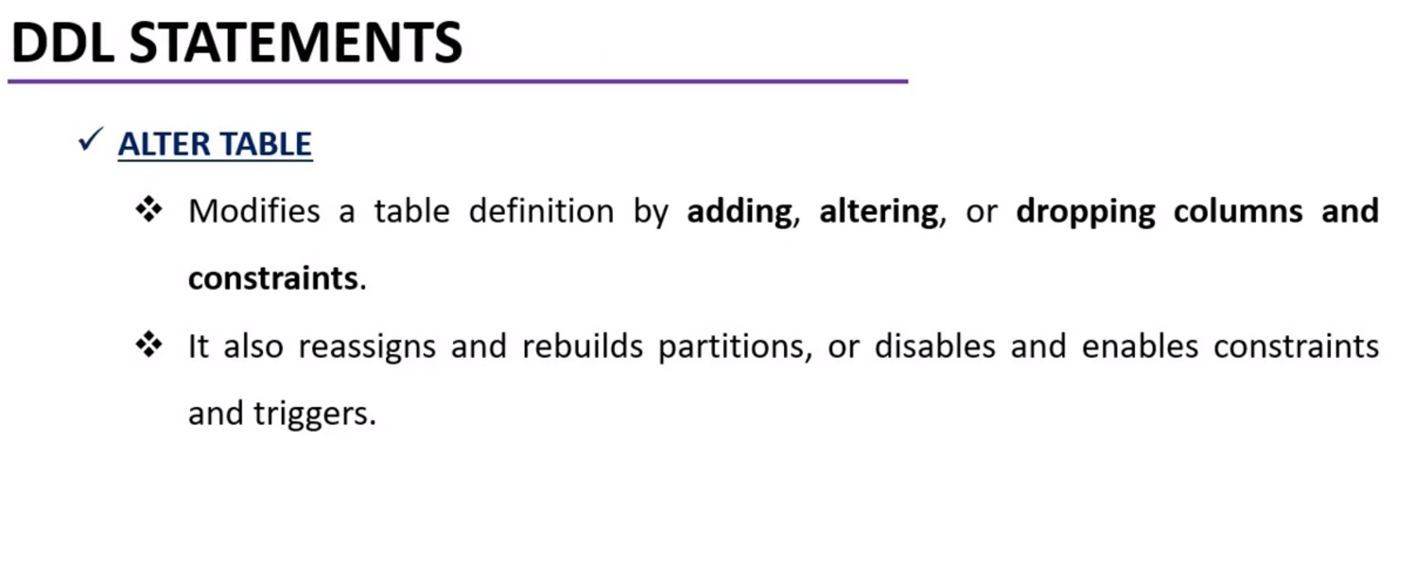

Slide 23
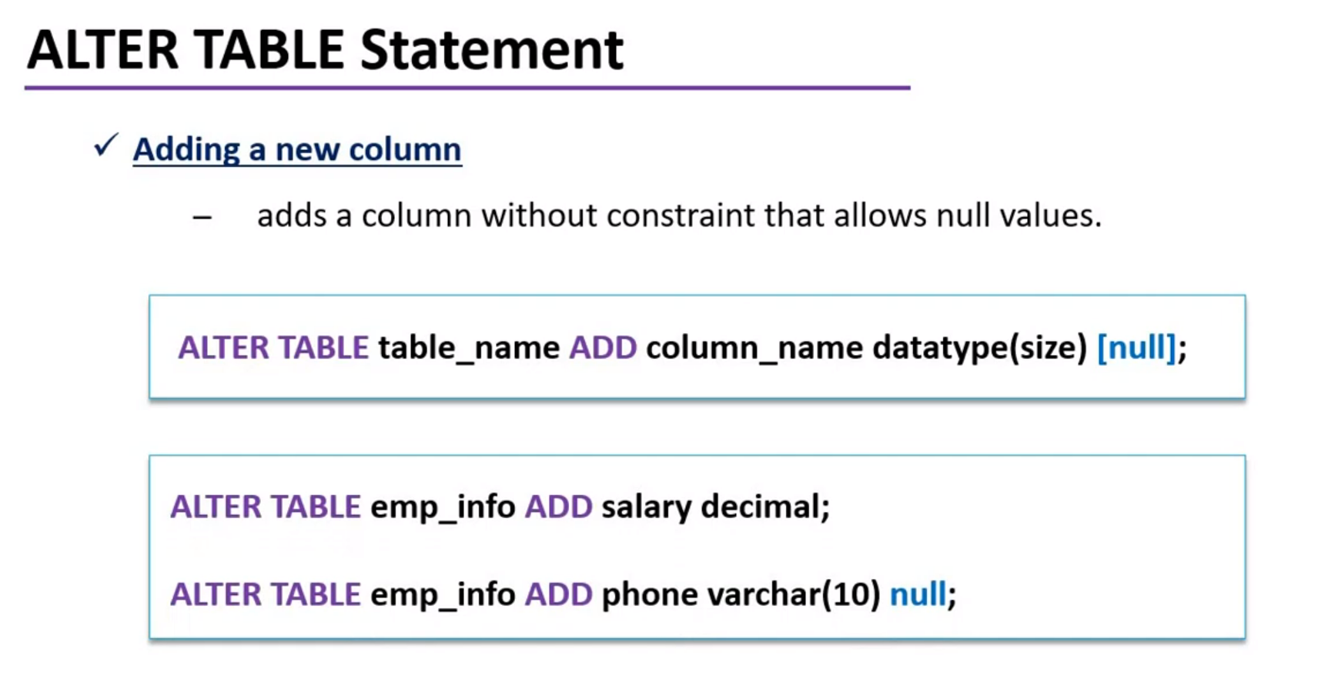

Slide 24
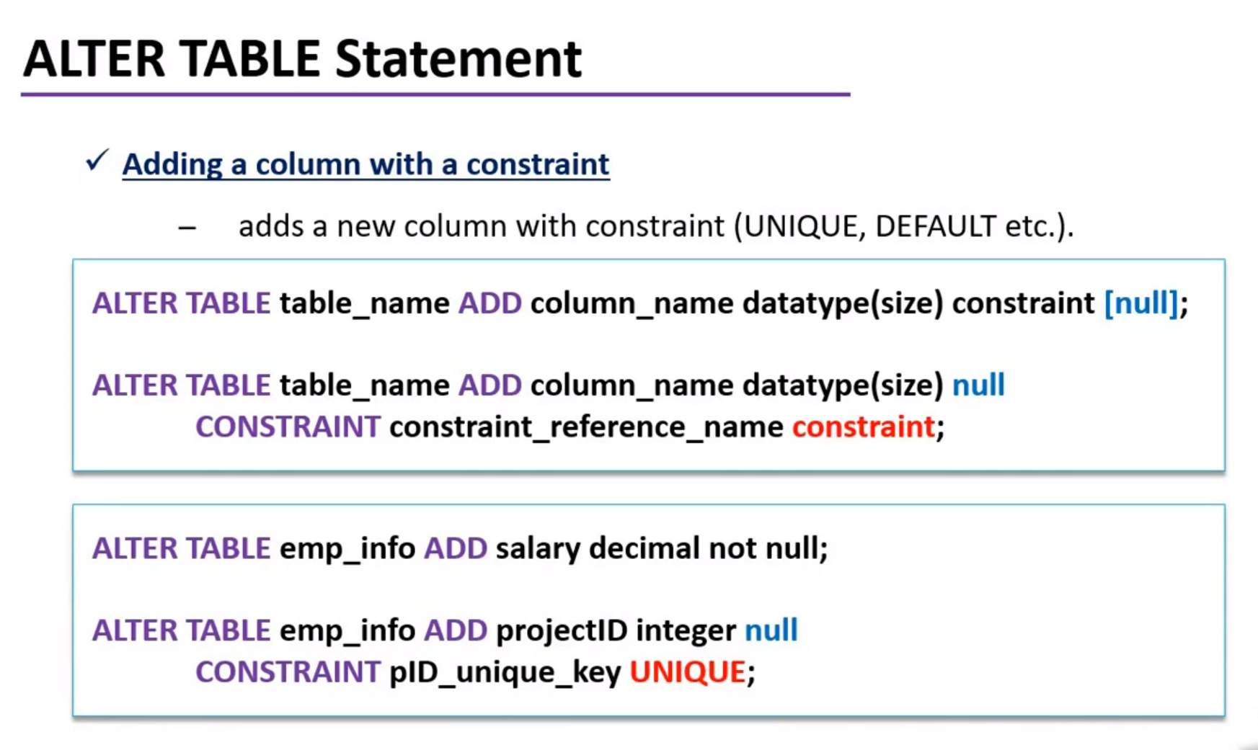

Slide 25
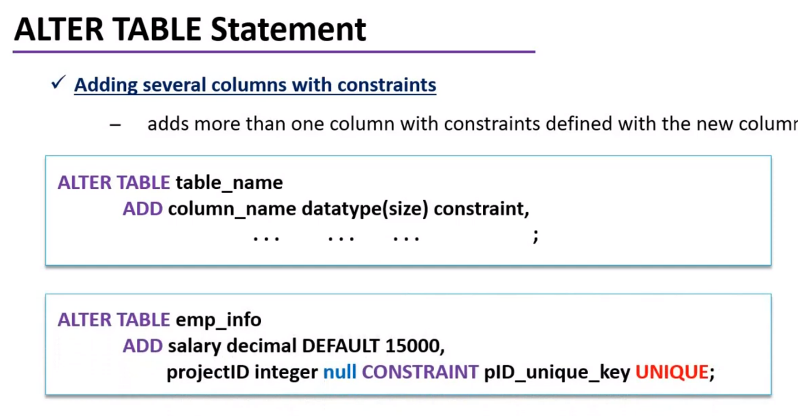

Slide 26
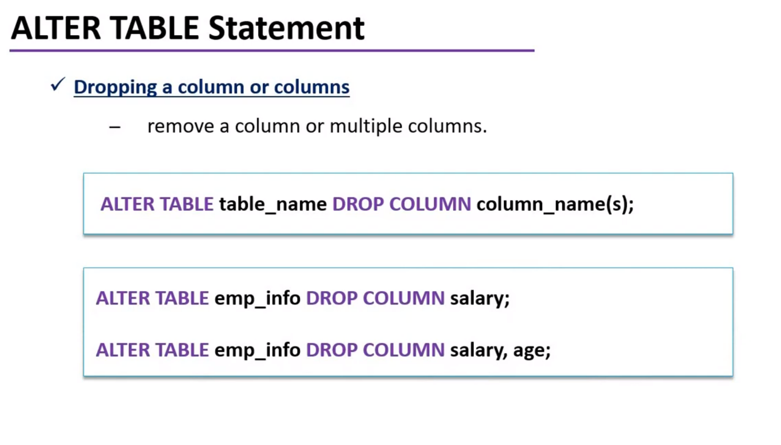

Slide 27
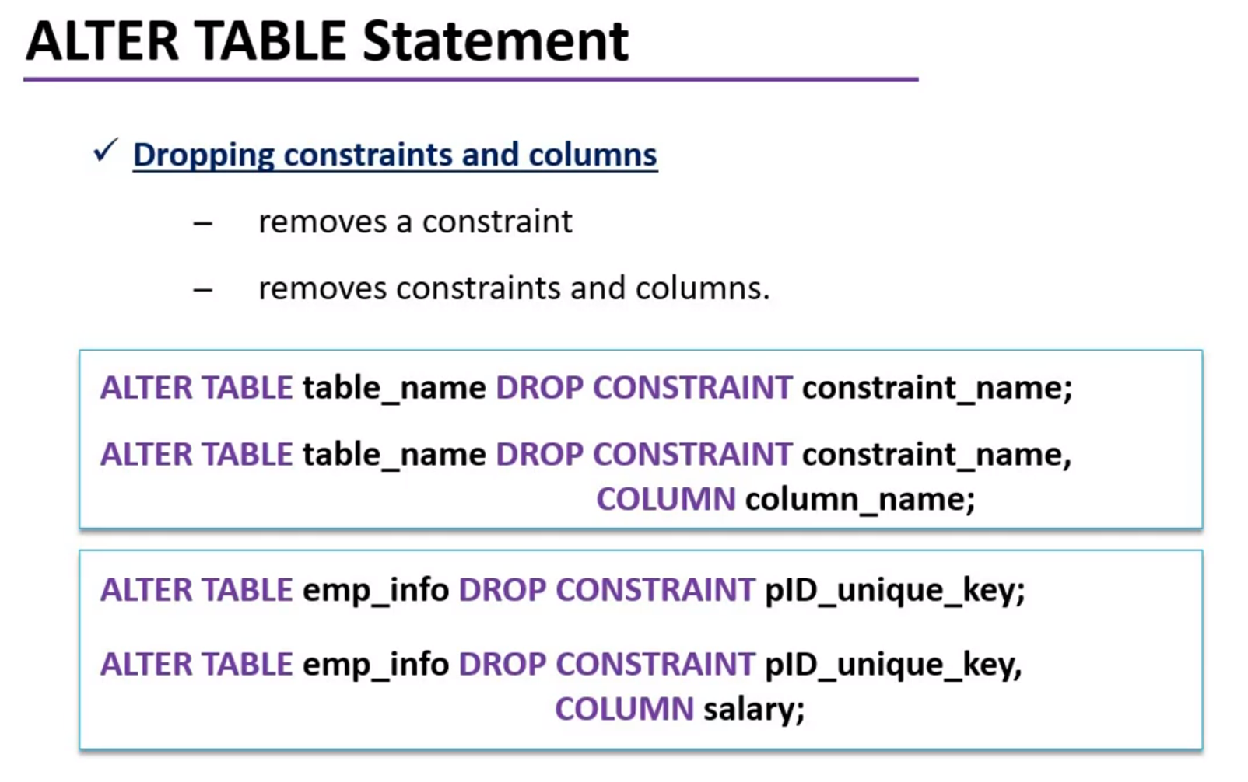

Slide 28
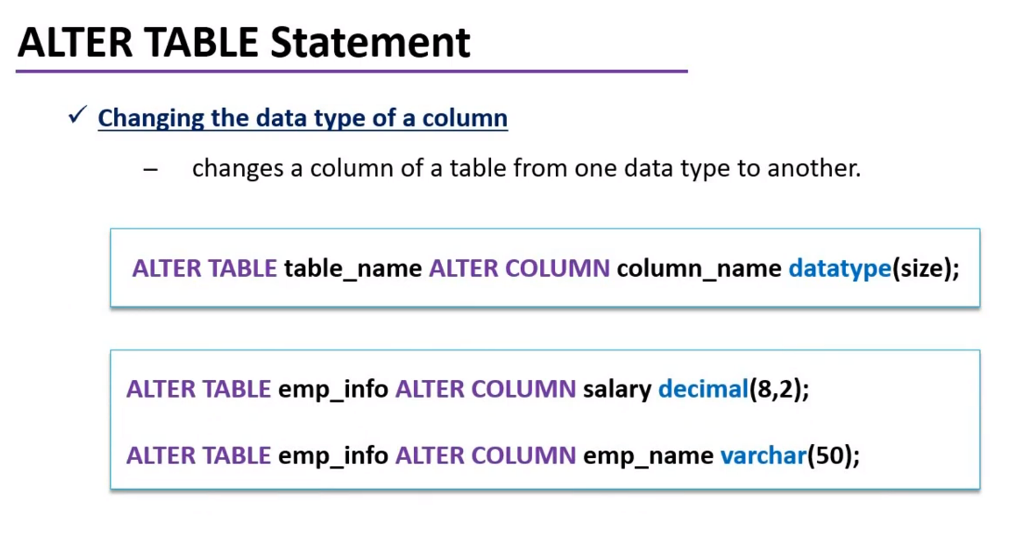

Slide 29
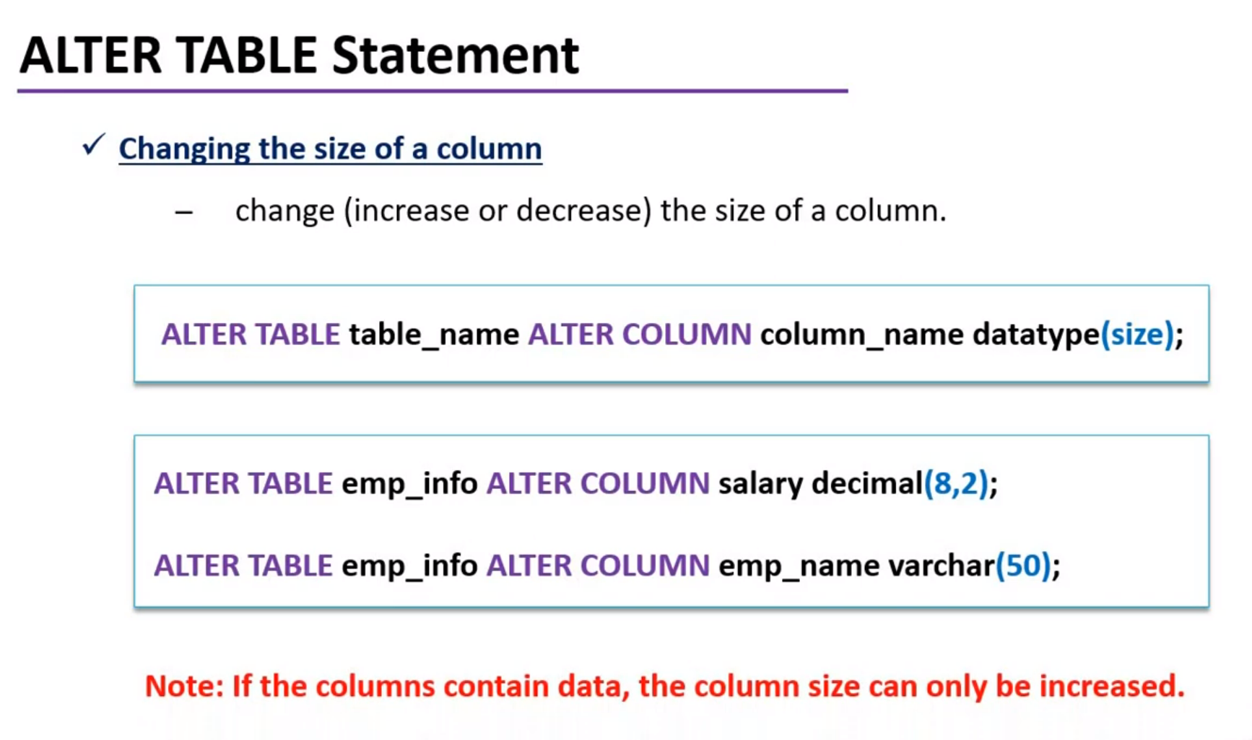

Slide 30
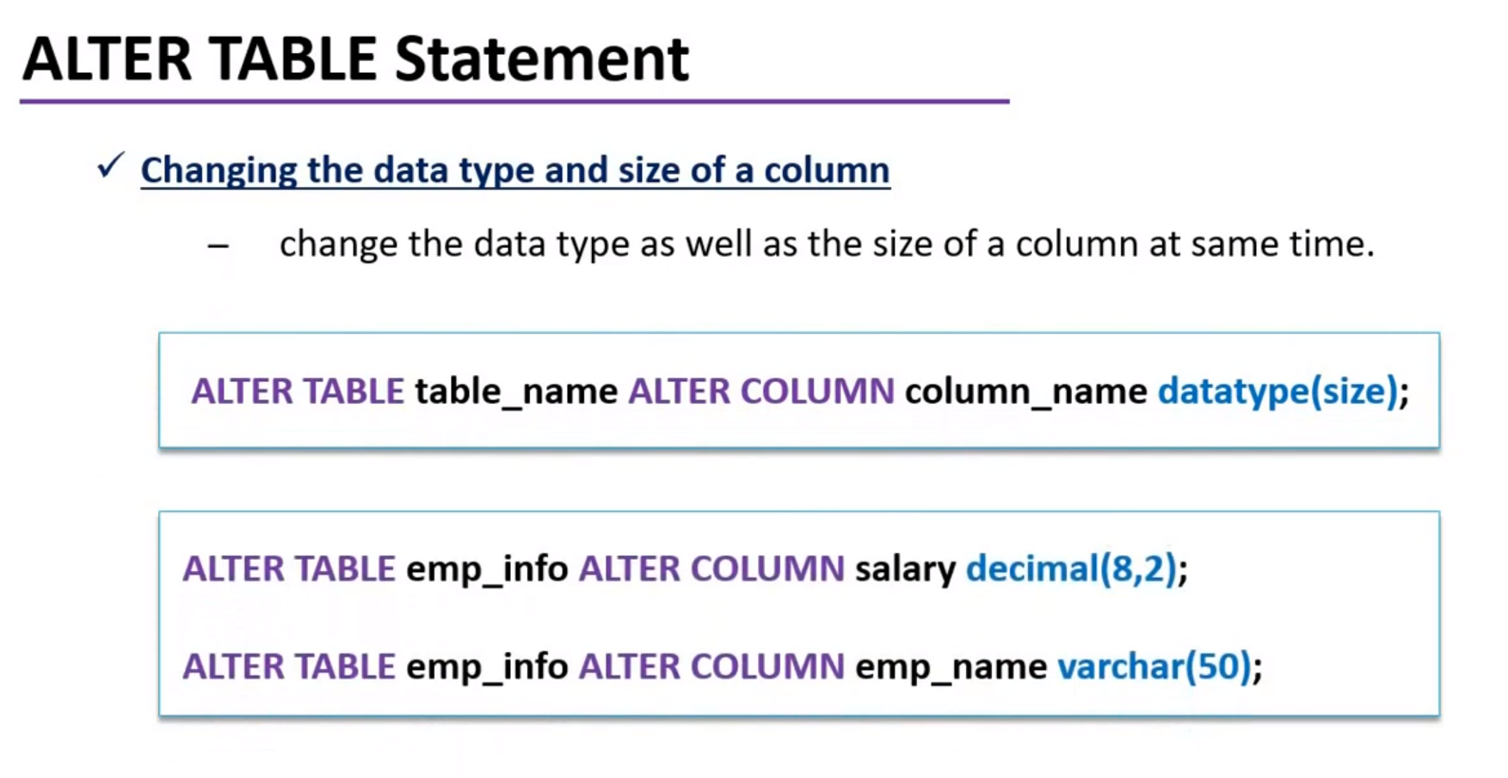

Slide 31
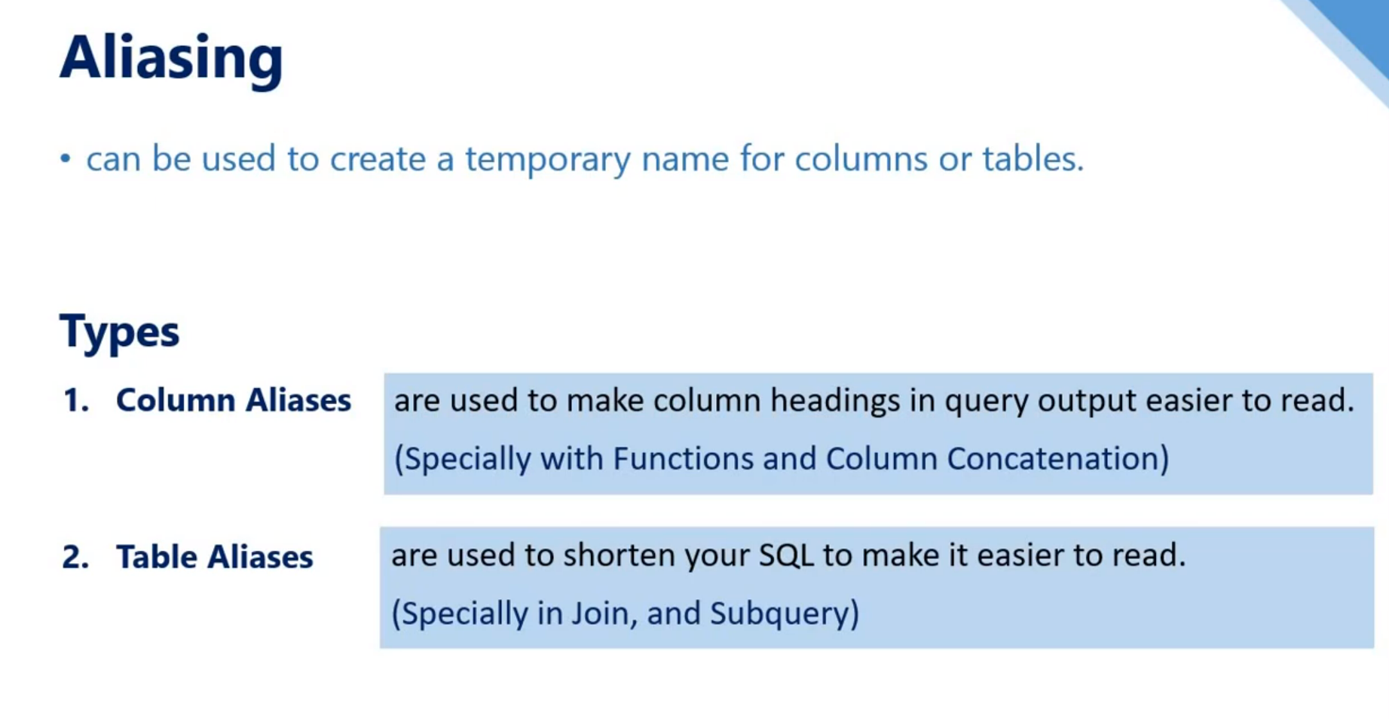

Slide 32
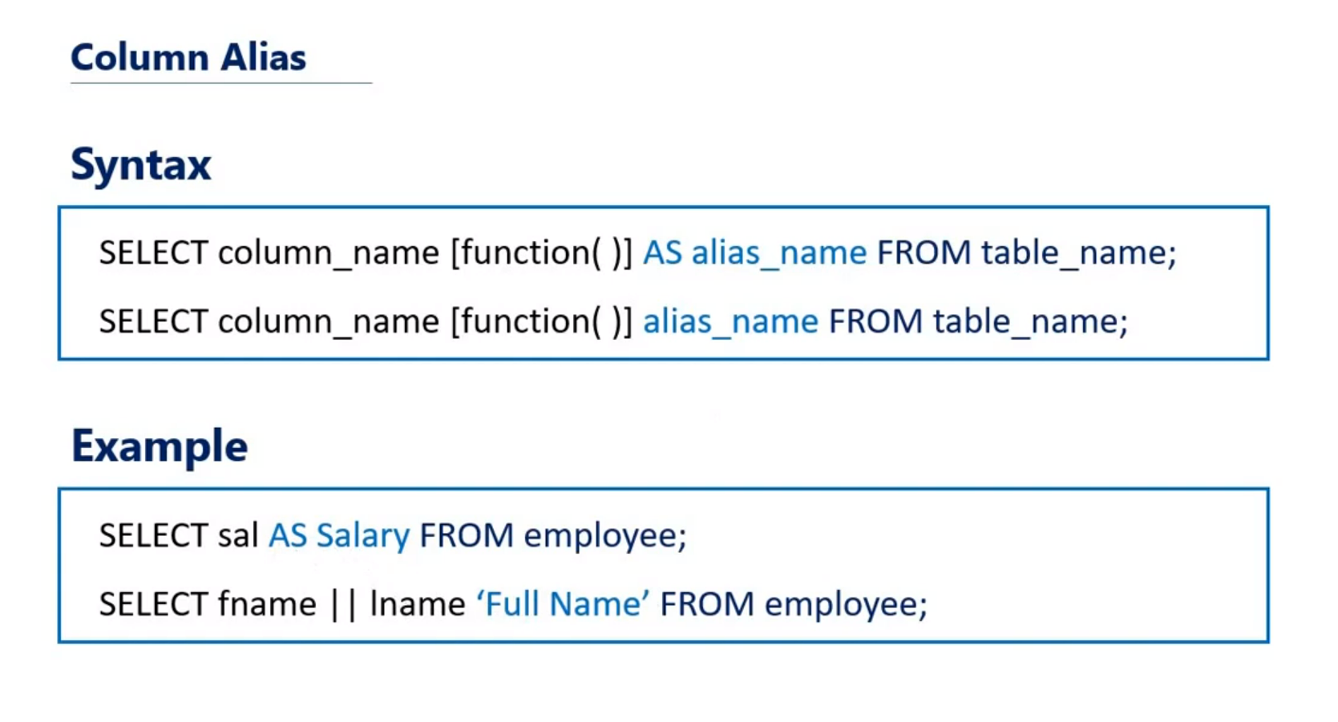

Slide 33
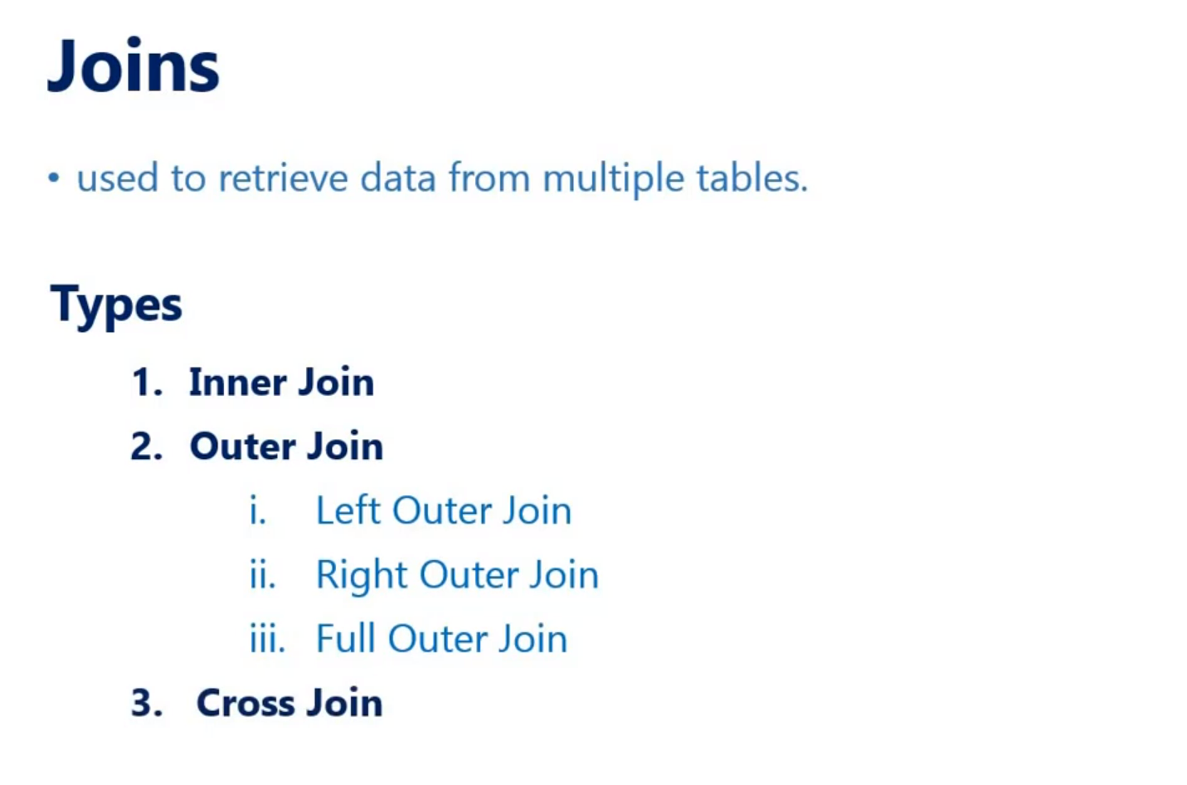

Slide 34
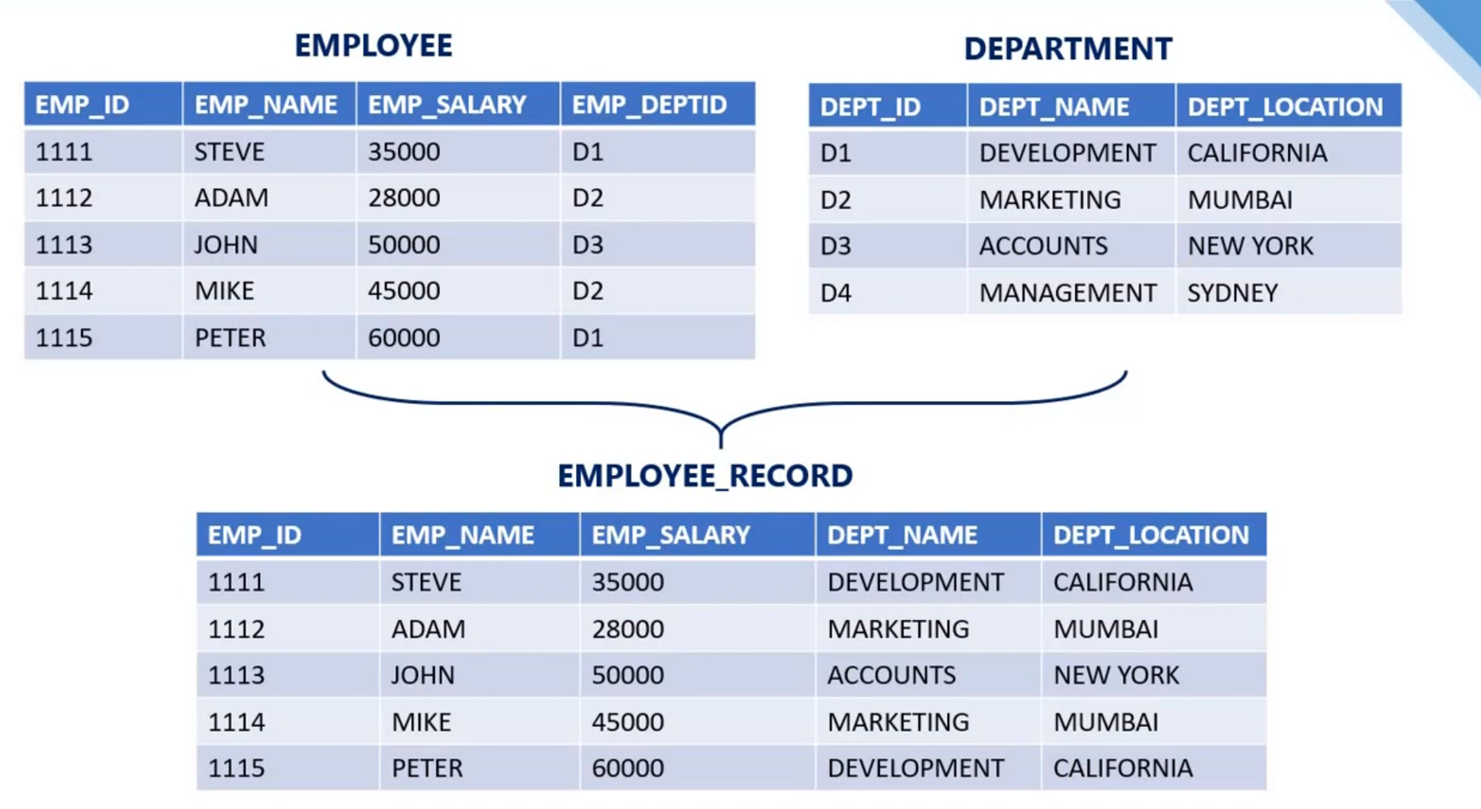

Slide 35
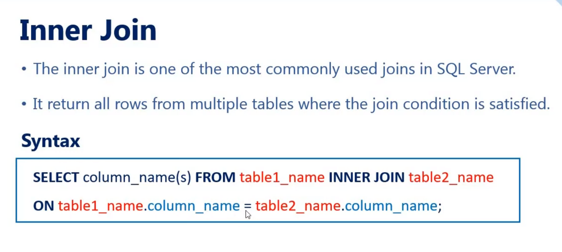

Slide 36
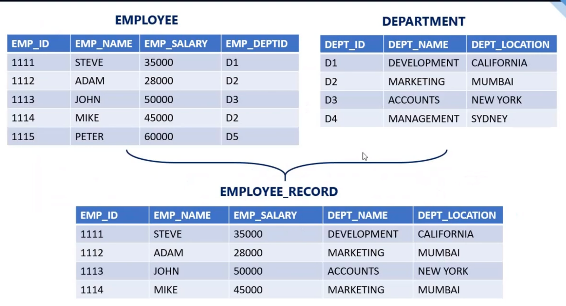

Slide 37
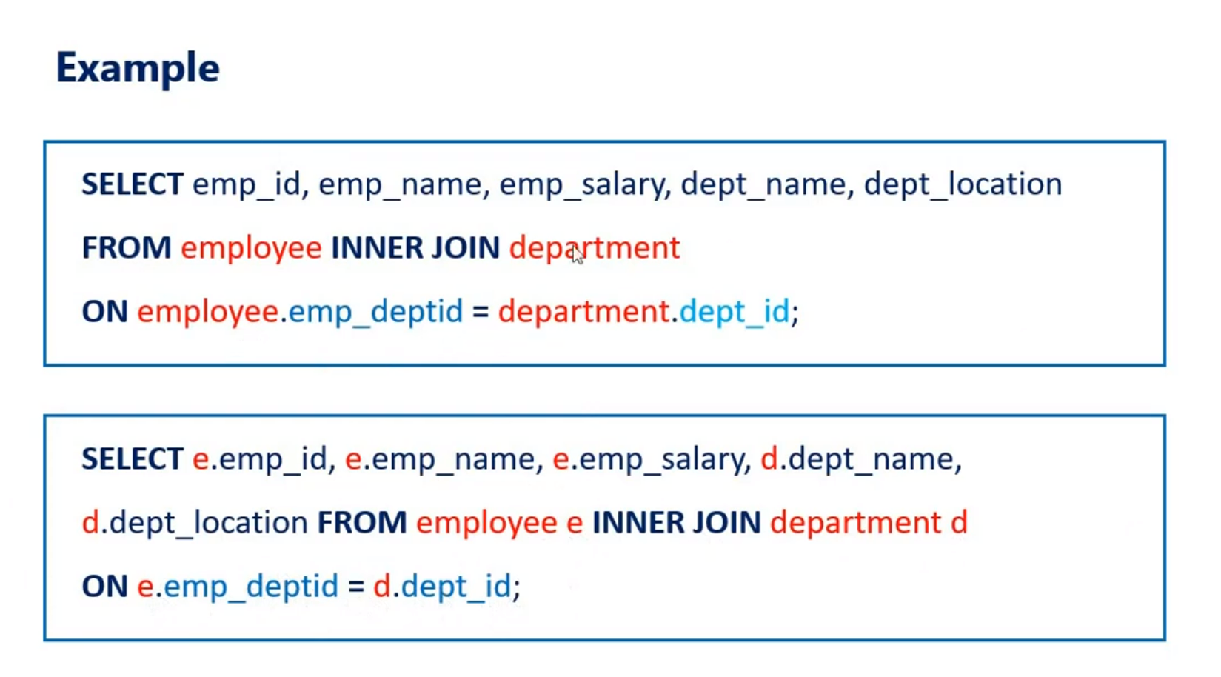

Slide 38
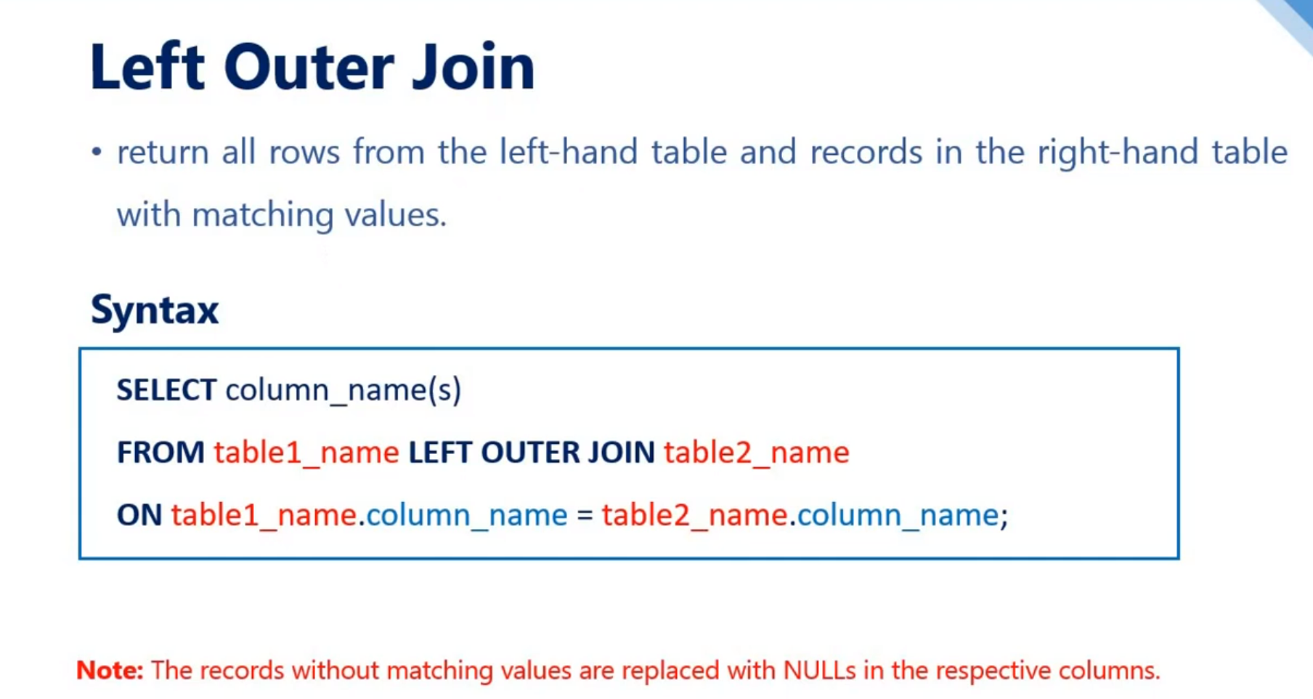

Slide 39
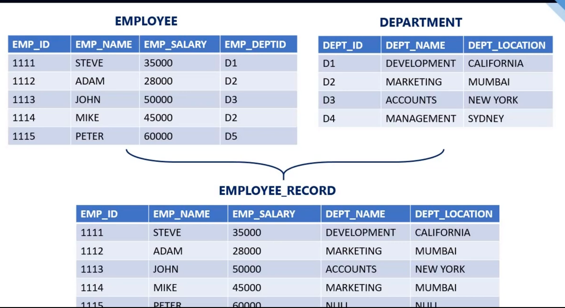

Slide 40
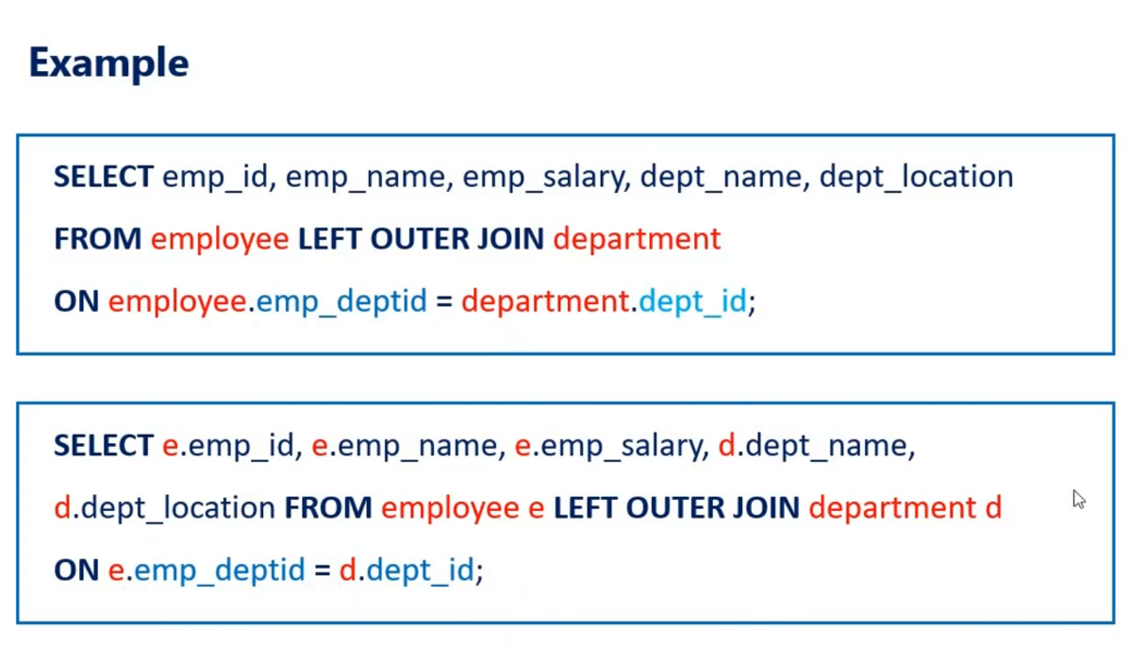

Slide 41
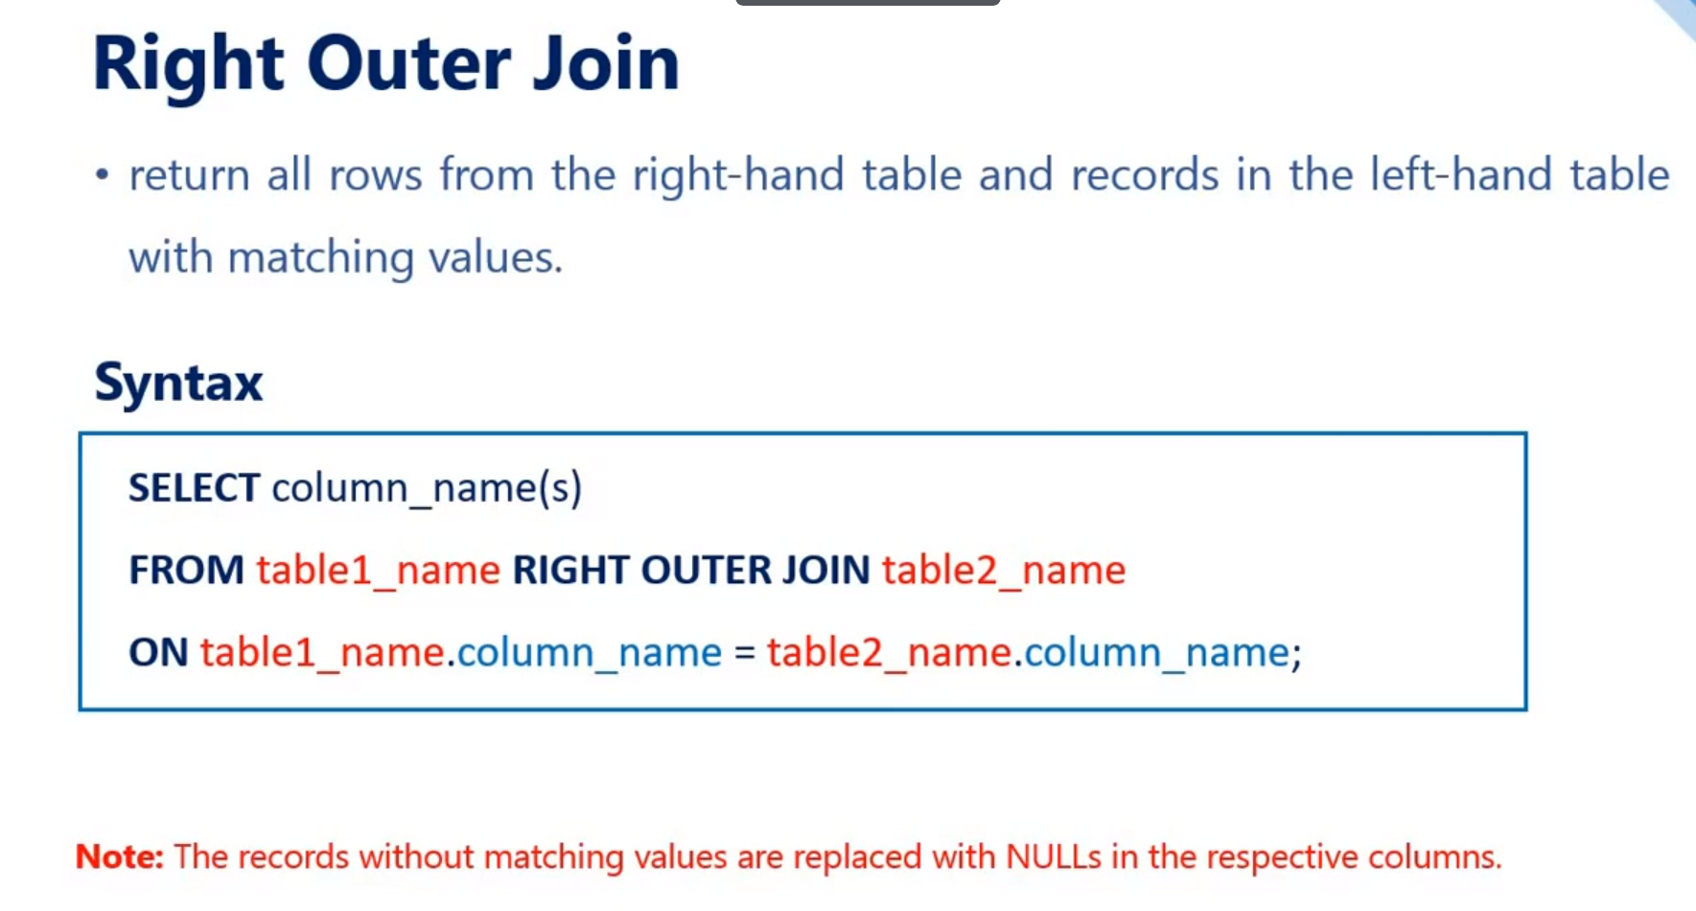

Slide 42
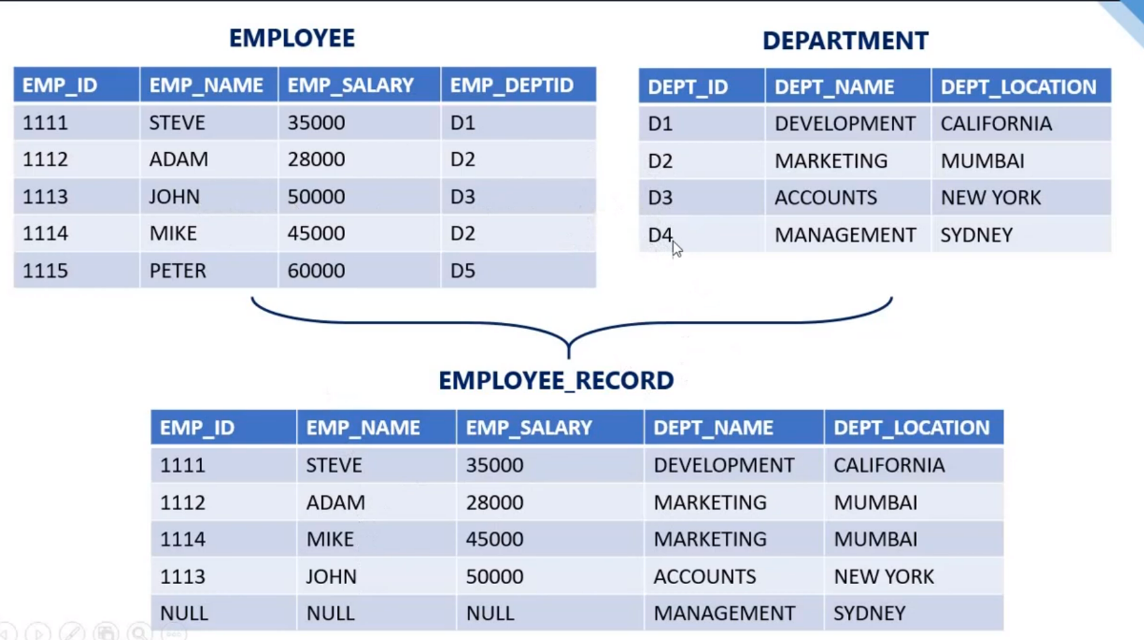

Slide 43
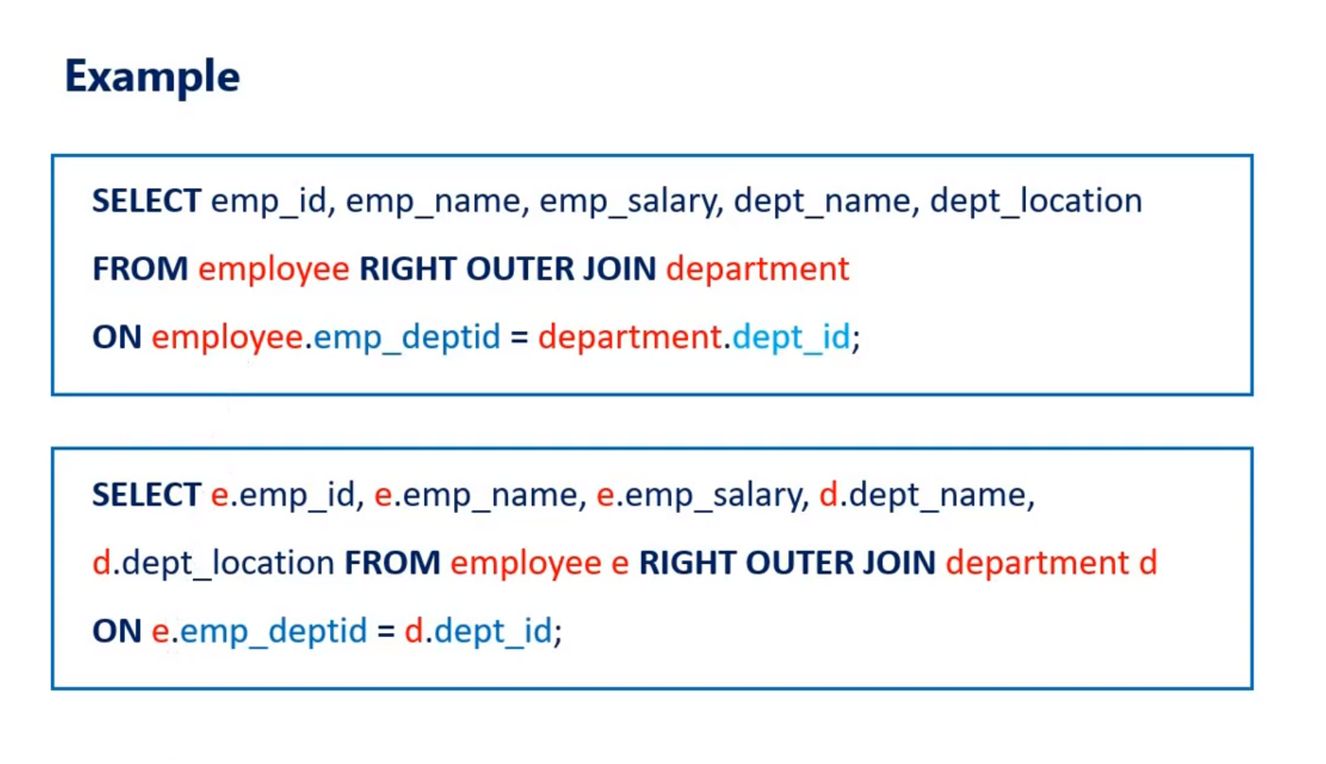

Slide 44
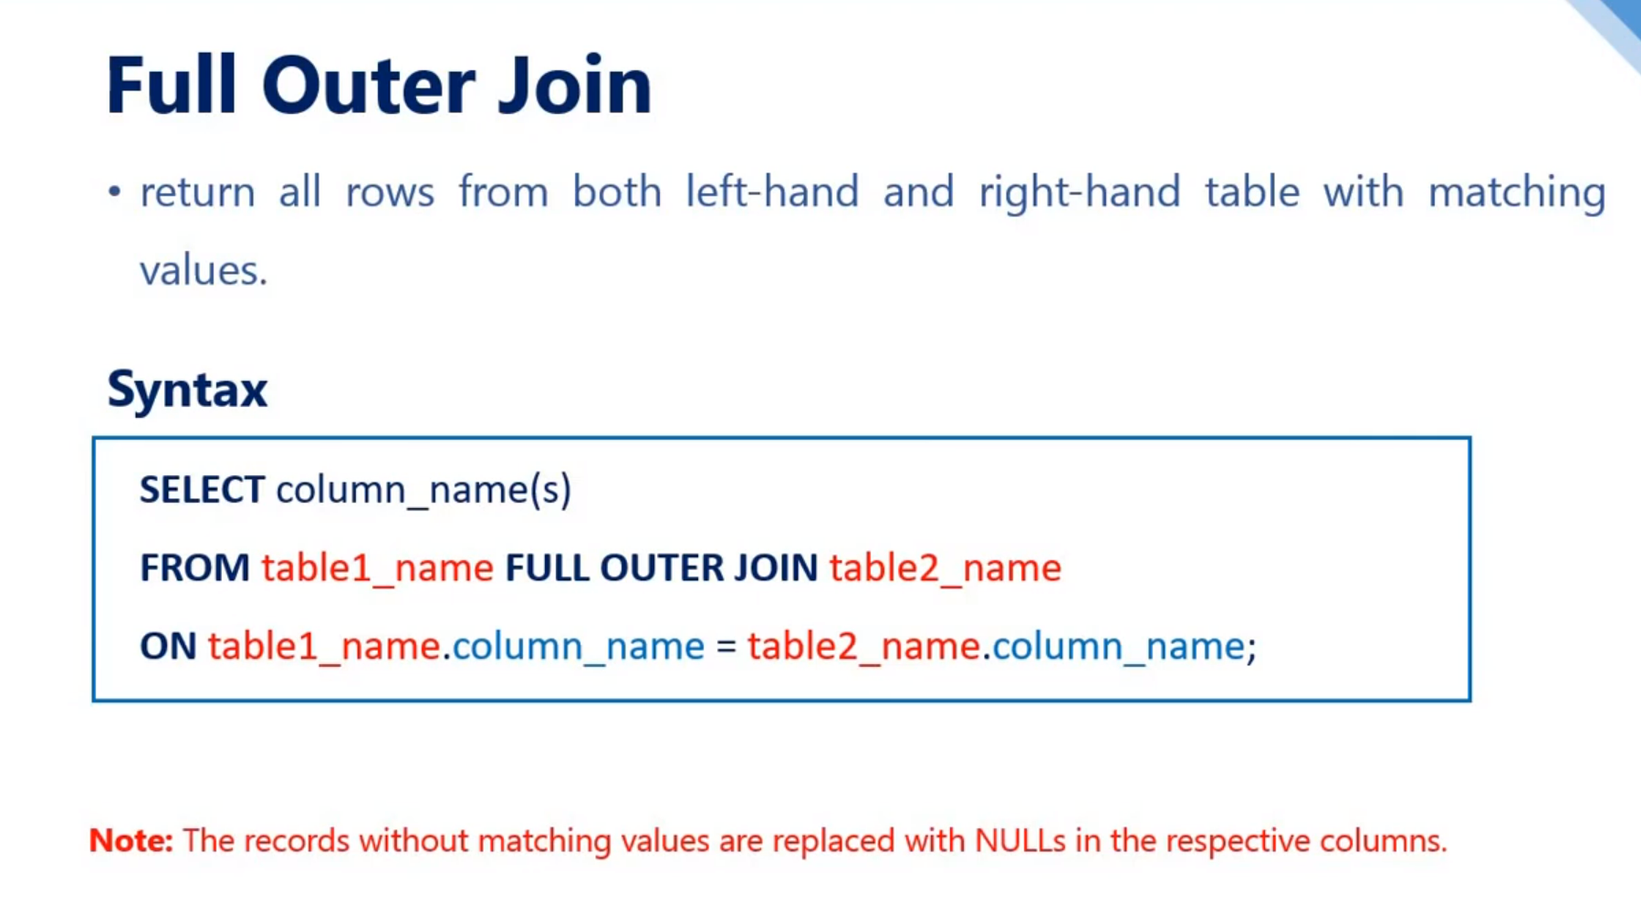

Slide 45
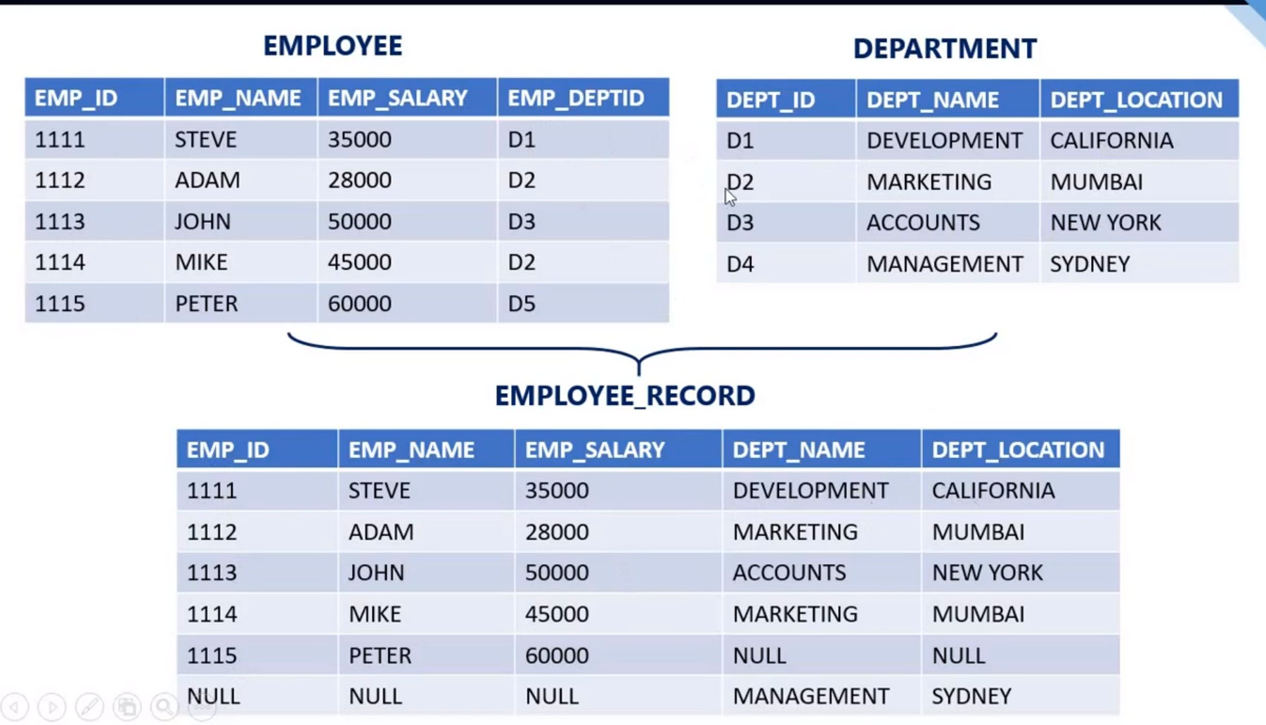

Slide 46
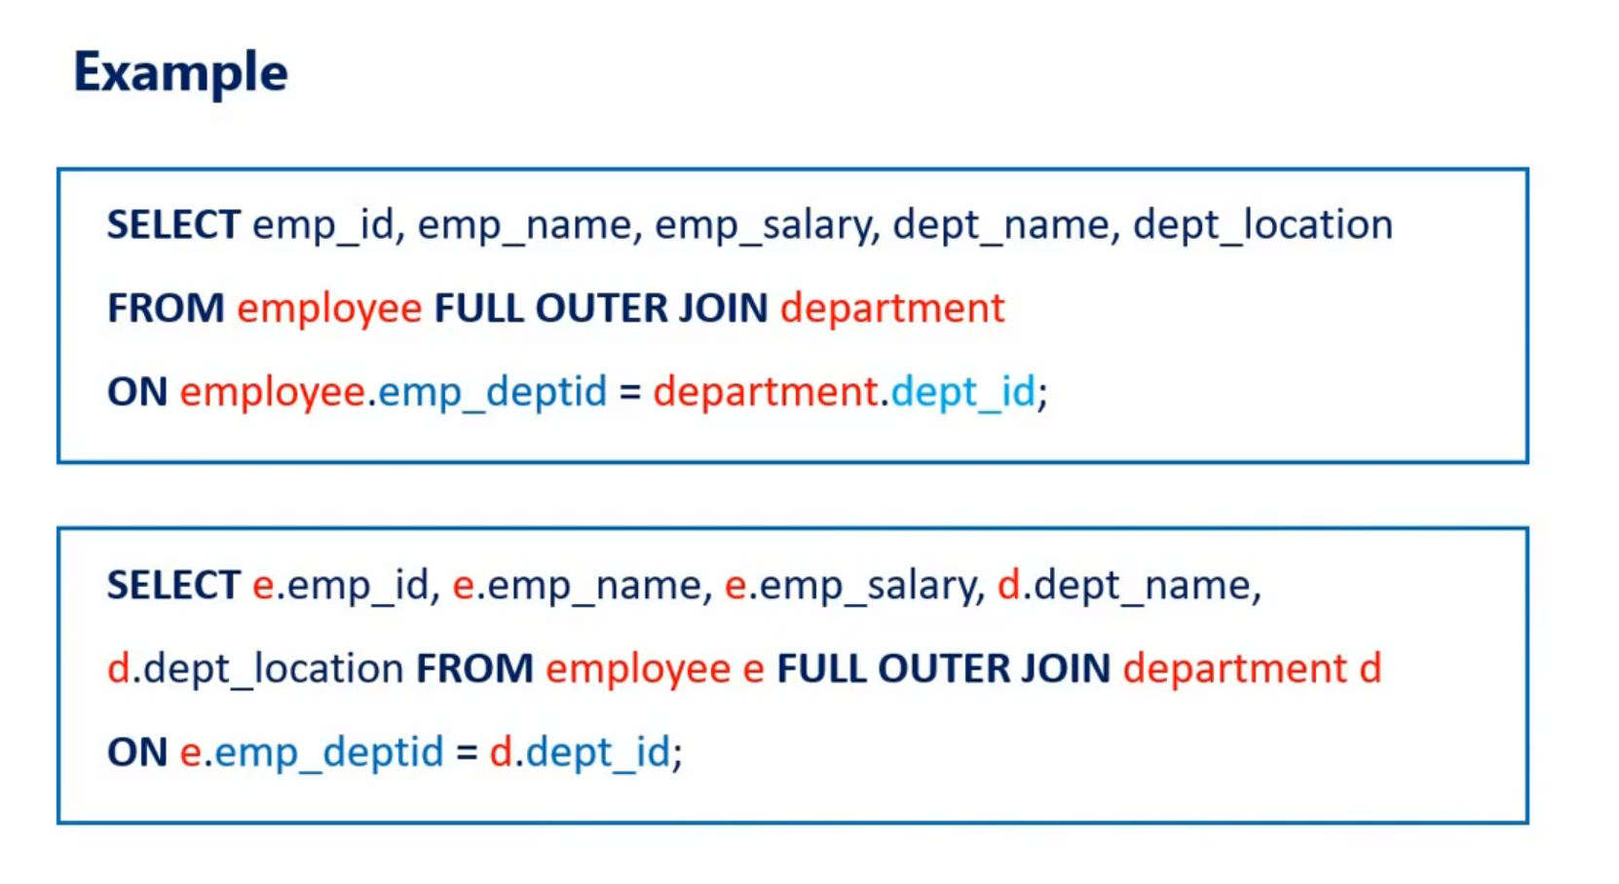

Slide 47
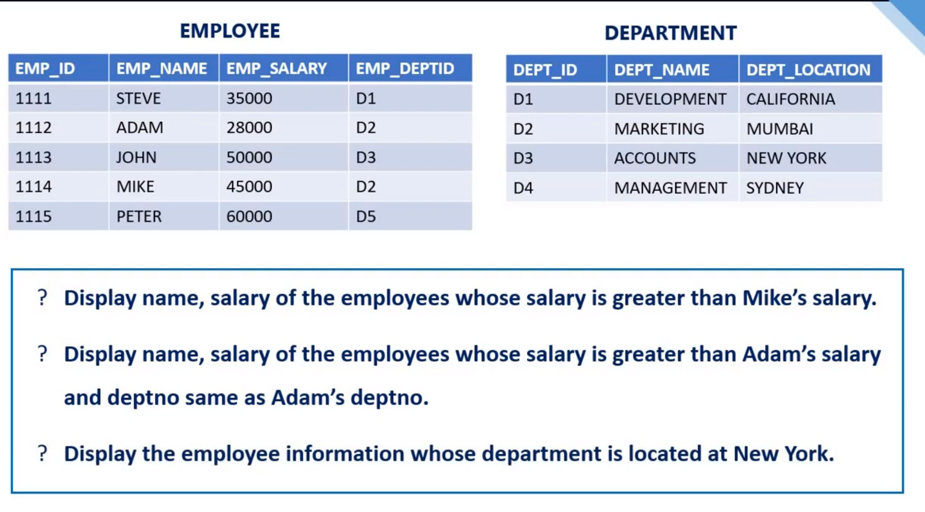

Slide 48
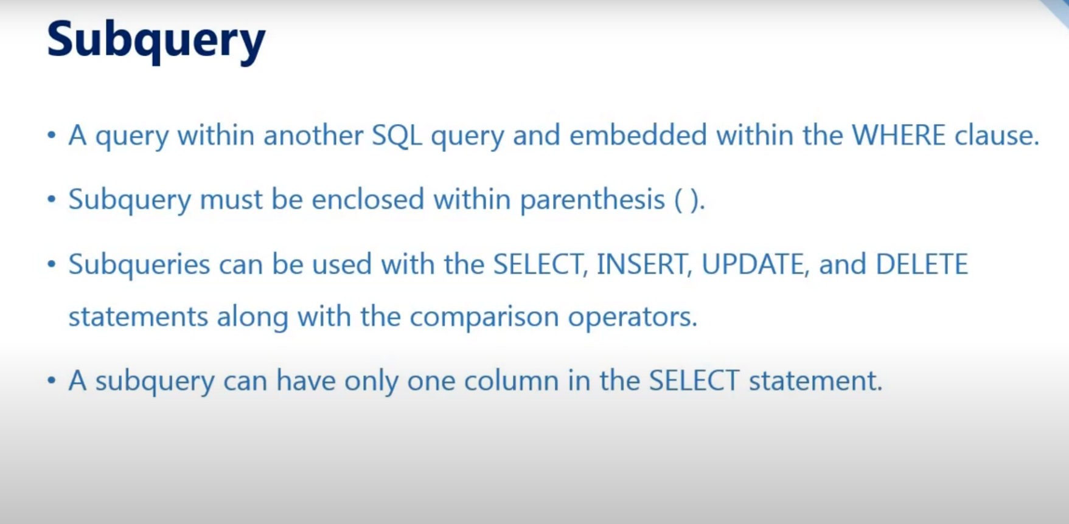

Slide 49
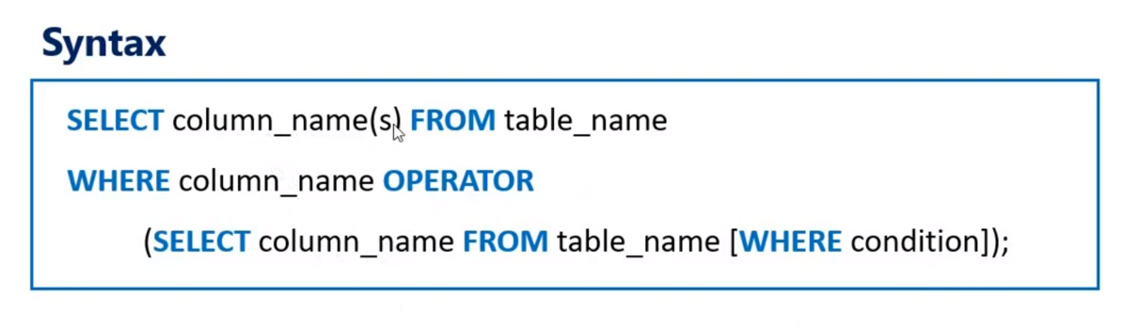

Slide 50
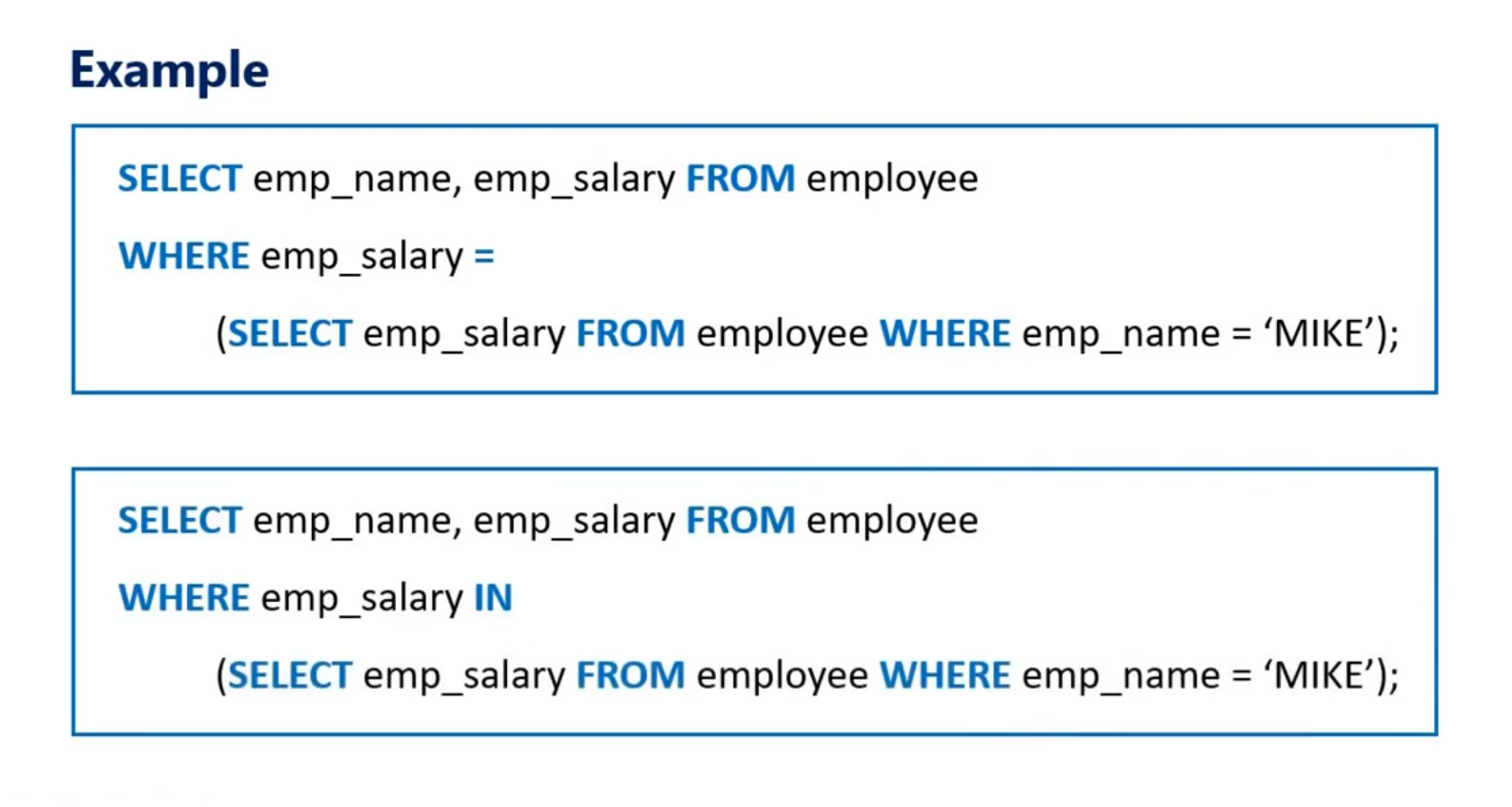

Slide 51
SQL SERVER BASICS DONE

